Slide 1

Module 0. As Class Begins…
Orientation: How do we learn economics? Especially now with COVID-19?
Video: Introduction to the course <https://www.icloud.com/keynote/0hKUPRSiDeqytMrEOMgwWUebA> <https://github.com/braddelong/public-files/blob/master/video-module-0-intro-2020-05-14.mp4> <https://www.youtube.com/watch?v=AnSjX8ClAXQ>
Readings:
Prefatory notes on Matuschak & Dasgupta
Andy Matuschak: Why Books Don’t Work <https://github.com/braddelong/public-files/blob/master/readings/article-matuschak-books.pdf>
Partha Dasgupta: Economics: A Very Short Introduction <https://github.com/braddelong/public-files/blob/master/readings/book-dasgupta-economics.pdf>
Discuss: Reaction to Readings for: 0. As Class Begins…
Lectures & q & a:
Lecture slides with Audio:
Sokrates v. Machiavelli on the educational process
Typical module activity flow
Dasgupta’s take on how to do economics
Logistics
Optional: A liberal education
Zoom Session: TBS (to be scheduled)
Problems & interactions:
Do: Introduction to Jupyter Notebooks
Discuss: Takeaways from & Extensions of: 0. As Class Begins…
Discussion thread
Breakout session
Addenda:
Text for Lectures on: 0. As…
Learning Goals for: 0. As…
Optional Further Readings…
Link
Link
<https://www.icloud.com/keynote/0FVJH3UuqPuq91KpU0jRc1vRQ>

Slide 2
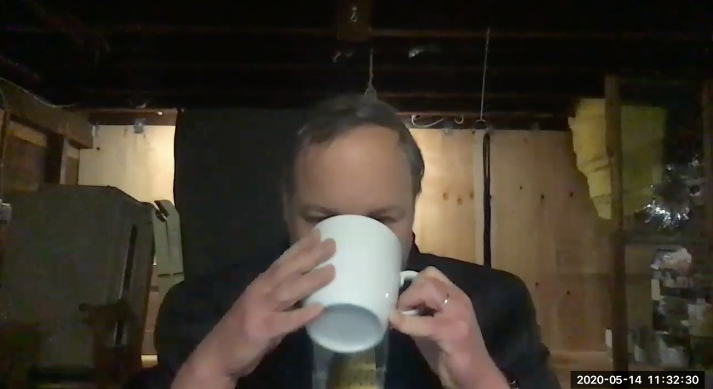
Introduction: Module 0.1. Welcome Video
What we are going to be doing in this Module 0 of the course. It is a meta-module: trying to learn how we will try to learn…
Welcome!: How do we learn? Especially now, with COVID-19, when we are online? We need an answer to that question if we are not going to make a hash of this…
Plus: What is economics? What is it good for?
<https://github.com/braddelong/public-files/blob/master/econ-115-module-0-1-intro-video-2020-08-08.mp4> <https://github.com/braddelong/public-files/blob/master/econ-115-module-0-1-welcome-%23tceh-%23remote.pptx> <https://www.youtube.com/watch?v=wNrtHTkJhKA>
13:30 of video
Notes:
Welcome to the course. I am Brad DeLong. This is my basement in the Elmwood neighborhood of Berkeley—near Ashby and college, about a mile south of the campus and about a mile north of the Rockridge BART.
Actually, that is not what it looks like now: this is a picture I took last May. What does it look like now? Behind myself as I sit at my basement desk, I have hung a green blanket. Why? To give the microprocessor in my laptop a fighting chance of distinguishing me from the background so that it can then do visual tricks to, hopefully, keep you somewhat engaged and slighty amused, and thus help you in the process of educating yourself.
What kind of tricks? Tricks like this.
This is a background against which, famously, a four-person fellowship was assigned a task in a movie.
But most of the time you will see backgrounds that are less overwhelming, while still being—we hope—visually interesting.
And most of the time you will see illustrations that will be—we hope—visually interesting and informative. This, for example, shows, week by week, from March to July 2020, how many American workers received unemployment insurance last week and had also received it the week before.
The collapse of employment and the rise of unemployment when the coronavirus plague hit was stunning: back in 2009 we had thought that the collapse of employment and the rise of unemployment in 2008-9 was stunningly big and stunningly fast. We were like John Snow in Game of Thrones: we knew nothing.
My voice, my face, my eyes, my mouth. Why have I filled your ears with the first, and put the others in front of your eyes—albeit off here in a corner? Why have I not simply assigned you some books, then said: “the exam will be in early December”, and left you to do your thing? Why are we making you glue your eyes to this screen? I have done do because we are built to find human faces and human voices uniquely arresting, interesting, and attention focusing.
Books are—a lot of the time—boring. In-person faces, gestures, and voices are a lot better.
How do we know this? We know this because the university survived the coming of printing. Let us back up two thousand years. Back then, when universities got their start, books were really, really expensive. The most comprehensive record of prices—or, rather, of what it was thought prices ought to be—in the distant past comes from an edict issued in the year 301 by the man who stabilized the resounded Roman Empire and gave it more centuries of life: the Emperor Diocletian. In his price edict he limited how much a scribe could charge for producing a copy of a book to 25 denarii to write 100 lines. What is the context? The context is that a 2.2-lb. loaf of bread costs 13 denarii, and to hire an unskilled worker for the day costs 36 denarii. A cheap book—the kind of thing you could get for, say, $10 today—thus cost the same as 440 pounds of bread, or 70 days’ work at minimum wage. Compare to today, when a cheap book costs the same as 5 pounds of bread, or 40 minutes’ work at minimum wage.
With books so expensive, how then did you get educated—unless you were already very rich to start with? The answer was that you had to travel to where the books were. With a cheap book costing the same proportion of the daily wage then as 70 days x 10 hours/day x 15/hour = 10,500 dollars is a proportion of the daily wage today, and with expensive high-quality durable books costing much more, how many books you needed to read, how many copies of, say, Aristotle’s _Nicomachean Ethics_ do you thin there were in Western Scotland in 1460? You traveled to the University of Glasgow. And there you—and all the others who wanted to learn about Aristotle’s _Nicomachean Ethics_, listened to somebody read the book aloud: “legit” it in a “lecture”, while you took your notes on it. Because afterwards your memory and your notes would be the only contact you had with Aristotle’s ideas: you certainly could not afford to spend the equivalent of $10,500 a book for anything other than your most favorite books.
That was the origin of the university: get people together to hear books read aloud. That was how universities got their start, back when books were really expensive. They were the only places you could read a few unpopoular books (in the library) and listen to the popular books books being read aloud (in the lectures). But then came Johann Gutenberg, and the printing press, and movable type, and books became really cheap. You could have your library, and read your books, almost anywhere. Yet universities did not disappear. And lectures did not disappear. They lost their principal purpose—of economizing on the number of copies of a book a univeristy needed to function—but they became: ways of getting people to go over again, in their minds, what they had read—structured repetition as a learning aid—of getting people to think actively about the ideas and connect them to things in their own mind, of getting people to engage in dialogues about the ideas, and in mobilizing human group solidarity for the educational process.
But we can no longer gather in lectures—or, rather, we do not want to run the risks involved in bringing all 100,000 or so people back to the Berkeley campus in the fall and have us act as we normally do, because we think that if we do so 60,000 of us will get sick and 500 of us—largely elderly professors and staff—die. So we are doing this instead. The problem is that making this work is very hard. We saw how hard a decade ago, with the big MOOC movement of a decade ago. Massive Open Online Courses were supposed to replace at least the in-person lecture course, and there were some who thought or hoped they would replace or at least totally transform the—expensive—university. They didn’t. Why not? It turned out to be very important to: (1) get people to do things in groups, (2) get people in the classroom in contact with each other outside the classroom, and (3) arrest and focus attention with live human voices and faces. And—as you know if you have thought about the difference between in-person plays and on-screen movies—there are lots of subtle and important ways in which our screen technologies just do not cut it.
Now, it can be done. The theme of which my first cousin Phil Lord down in Ell-Ay was one of the heads did it. But they spent $500,000 per minute creating _Spiderman: Into the Spiderverse_. Do that, and you can create something that is fully immersive and more effective than anything we see in person. Of course, you need more than money: you need genius too, and a lot of luck.
How much luck? Consider _Solo: A Star Wars Story_. The team composed of Phil and company were bounced out of the project in the middle due to “creative differences”. As I understand it, they had proposed to make a Star Wars movie that was a lot more like _Guardians of the Galaxy_ had been. They were given the greenlight. But in the middle of the project the Disney executives decided that the movie that they did not want to eat what they had ordered. So I will never see Phil, Chris, and the team’s view of the Han Solo origin story. Instead, we have a movie that lost Disney $80 million, and that brought a screaming halt to a number of projects—in fact, to all of what was supposed to be a series of future Star Wars origin spinoffs. Making convincing and arresting video is very hard.
We thus have an uphill climb. We don’t have $500K/minute to spend. And we here are not creative geniuses like my first cousin Phil and his team are. American universities are frantically piling online so that we can keep teaching. And as we do so we face an intellectual crisis about how to do our job through a screen—which is a very difficult task. Unless and until we successfully figure out how to do our job through a screen, we are going to make a total hash of moving online. Hence this first, preliminary, module of this course: a meta-module; a “how are we going to try to learn this semester” module. And also in this module I also ask and suggest some possible answers to the questions: what is economics? And: what is economics good for?
Once again: welcome. I very much hope you learn stuff here, wherever “here” is, virtually. And I very much hope you have some fun here this semester.

Slide 3

My Green Blanket
Notes:
Welcome to the course. I am Brad DeLong. This is my basement in the Elmwood neighborhood of Berkeley—near Ashby and college, about a mile south of the campus and about a mile north of the Rockridge BART.
Actually, that is not what it looks like now: this is a picture I took last May. What does it look like now? Behind myself as I sit at my basement desk, I have hung a green blanket. Why? To give the microprocessor in my laptop a fighting chance of distinguishing me from the background so that it can then do visual tricks to, hopefully, keep you somewhat engaged and slighty amused, and thus help you in the process of educating yourself.

Slide 4
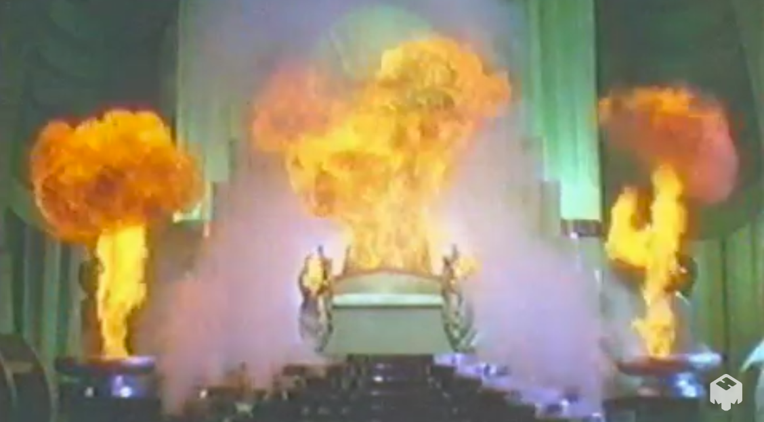
Throne Room, Palace of the Wizard, Oz
Notes:
What kind of tricks?

Slide 5
Your Task
Accomplishing it should be straightforward…
The Wizard, The Palace, Emerald City
Notes:
Tricks like this.

Slide 6
BRING ME THE BROOMSTICK OF THE WICKED WITCH OF THE WEST!
The Wizard, The Palace, Emerald City
Notes:
This is a background against which, famously, a four-person fellowship was assigned a task in a movie.

Slide 7

Berkeley at Dusk, Facing the Golden Gate
Notes:
But most of the time you will see backgrounds that are less overwhelming, while still being—we hope—visually interesting.

Slide 8
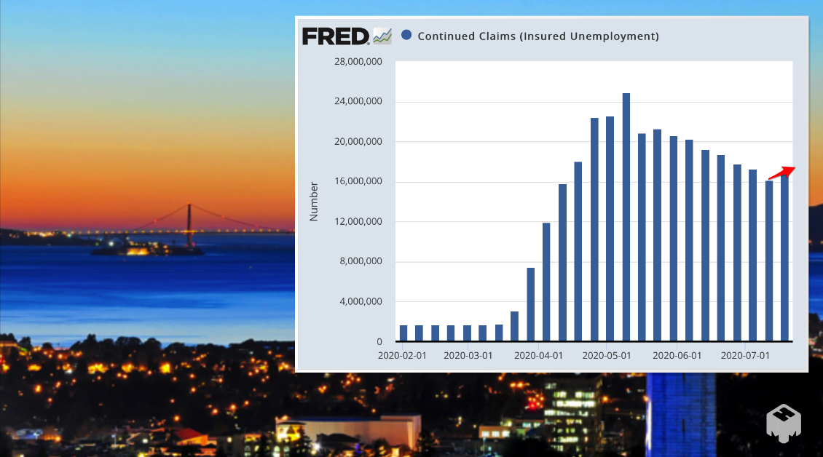
Continued Claims, March-July 2020
Notes:
And most of the time you will see illustrations that will be—we hope—visually interesting and informative. This, for example, shows, week by week, from March to July 2020, how many American workers received unemployment insurance last week and had also received it the week before.

Slide 9
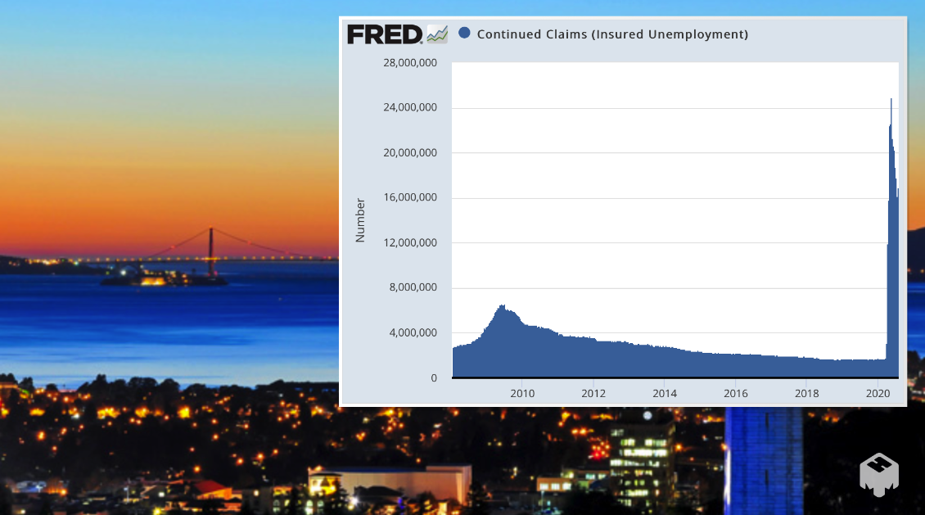
Continued Claims, 2007-2020
Notes:
The collapse of employment and the rise of unemployment when the coronavirus plague hit was stunning: back in 2009 we had thought that the collapse of employment and the rise of unemployment in 2008-9 was stunningly big and stunningly fast. We were like John Snow in Game of Thrones: we knew nothing.

Slide 10

Brad DeLong Title Slide
Notes:
My voice, my face, my eyes, my mouth. Why have I filled your ears with the first, and put the others in front of your eyes—albeit off here in a corner? Why have I not simply assigned you some books, then said: “the exam will be in early December”, and left you to do your thing? Why are we making you glue your eyes to this screen? I have done do because we are built to find human faces and human voices uniquely arresting, interesting, and attention focusing. Books are—a lot of the time—boring. In-person faces, gestures, and voices are a lot better.

Slide 11

Why a Video?
Why not simply put a bunch of books in front of you?
And why not then say: “the exam is in early December”?
Why not? Because:
Books are—very often— boring.
Voices and faces are not—usually—boring.
People gain morale doing things in groups.
——
<https://ostrichpillow.com/>
Notes:
Books are—a lot of the time—boring. In-person faces, gestures, and voices are a lot better.

Slide 12
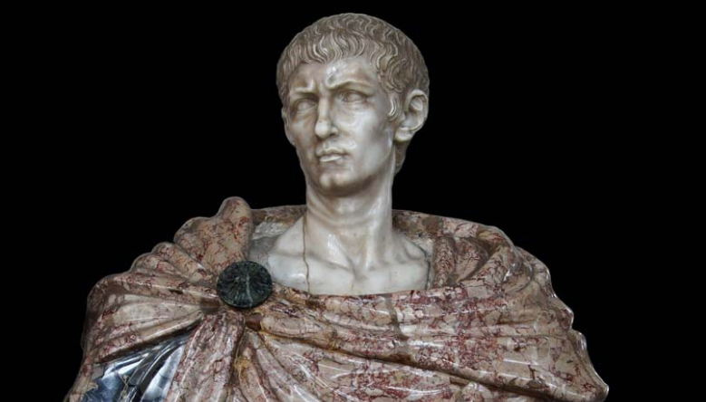
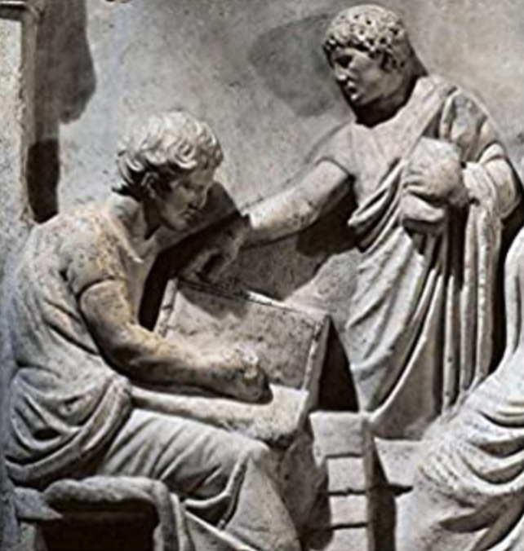
Books Used to Be Very Expensive
Go back 2000 years: Gaius Valerius Diocles:
Imperator Caesar Gaius Aurelius Valerius Diocletianus Augustus
244-311; ruled 286-305
Price Edict of 301: 25 𐆖 for 100 lines
440 lbs of bread for a cheap book; today it’s 5
$1000 for a cheap book; 10x or 20x that for high-quality one…
——
<https://github.com/braddelong/public-files/blob/master/readings/article-allen-prosperous-romans.pdf>
<https://github.com/braddelong/public-files/blob/master/readings/article-diocletian-price-edict-kropff.pdf>
Notes:
How do we know this? We know this because the university survived the coming of printing. Let us back up two thousand years. Back then, when universities got their start, books were really, really expensive. The most comprehensive record of prices—or, rather, of what it was thought prices ought to be—in the distant past comes from an edict issued in the year 301 by the man who stabilized the resounded Roman Empire and gave it more centuries of life: the Emperor Diocletian. In his price edict he limited how much a scribe could charge for producing a copy of a book to 25 denarii to write 100 lines. What is the context? The context is that a 2.2-lb. loaf of bread costs 13 denarii, and to hire an unskilled worker for the day costs 36 denarii. A cheap book—the kind of thing you could get for, say, $10 today—thus cost the same as 440 pounds of bread, or 70 days’ work at minimum wage. Compare to today, when a cheap book costs the same as 5 pounds of bread, or 40 minutes’ work at minimum wage.

Slide 13

How Do You Then Get Educated?
TRAVEL TO WHERE THE BOOKS ARE:
Just how many copies of the Nicomachean Ethics are there in Western Scotland, anyway?
Listen to the book being read aloud
And take your notes…
LECTURE:
NOUN: An educational talk to an audience, especially one of students in a university. ‘in each course there are supporting lectures and tutorials’.
Origin: Late Middle English (in the sense ‘reading, a text to read’): from Old French, or from medieval Latin lectura, from Latin lect- ‘read, chosen’, from the verb legere.
Pronunciation: lecture /ˈlɛktʃə/
Notes:
With books so expensive, how then did you get educated—unless you were already very rich to start with? The answer was that you had to travel to where the books were. With a cheap book costing the same proportion of the daily wage then as 70 days x 10 hours/day x 15/hour = 10,500 dollars is a proportion of the daily wage today, and with expensive high-quality durable books costing much more, how many books you needed to read, how many copies of, say, Aristotle’s _Nicomachean Ethics_ do you thin there were in Western Scotland in 1460? You traveled to the University of Glasgow. And there you—and all the others who wanted to learn about Aristotle’s _Nicomachean Ethics_, listened to somebody read the book aloud: “legit” it in a “lecture”, while you took your notes on it. Because afterwards your memory and your notes would be the only contact you had with Aristotle’s ideas: you certainly could not afford to spend the equivalent of $10,500 a book for anything other than your most favorite books.

Slide 14
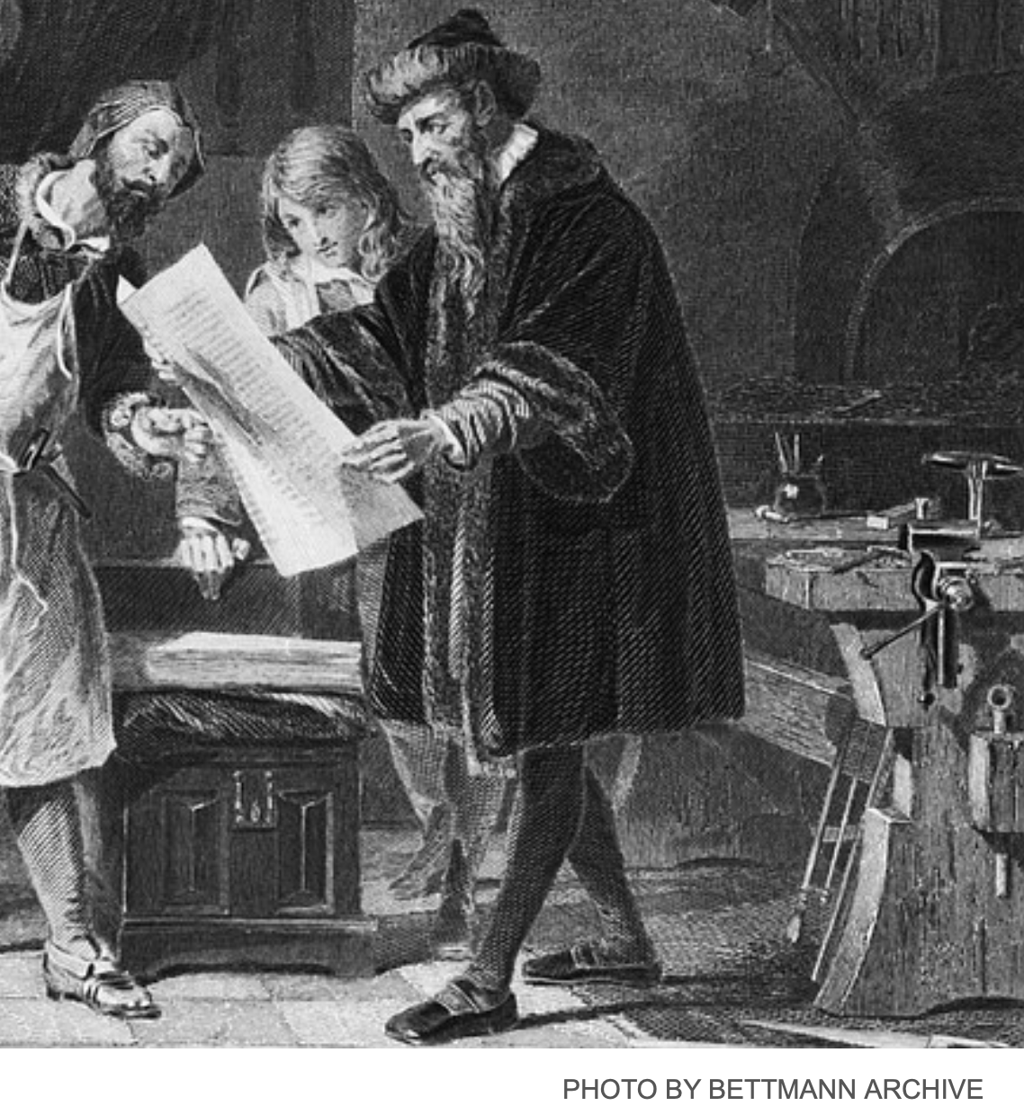
Gutenberg Arrives!
Scribes: 3000 words a day:
Max Roser: In 1483… three florins… Ripoli… produced 1,025 copies… the scribe would produce one copy for one florin… cost per book decreased 341 times <http://tinyurl.com/ybvbww3n>...
Another 20x since: $70,000 to $10
Yet the university remains:
“Lectures” then become…
Structured repetition in different channels (eyes, ears)
Commentaries, highlights, & dialogues—real or constructed—about the text
Notes:
That was the origin of the university: get people together to hear books read aloud. That was how universities got their start, back when books were really expensive. They were the only places you could read a few unpopoular books (in the library) and listen to the popular books books being read aloud (in the lectures). But then came Johann Gutenberg, and the printing press, and movable type, and books became really cheap. You could have your library, and read your books, almost anywhere. Yet universities did not disappear. And lectures did not disappear. They lost their principal purpose—of economizing on the number of copies of a book a univeristy needed to function—but they became: ways of getting people to go over again, in their minds, what they had read—structured repetition as a learning aid—of getting people to think actively about the ideas and connect them to things in their own mind, of getting people to engage in dialogues about the ideas, and in mobilizing human group solidarity for the educational process.

Slide 15

Yet the University Remains
Notes:
The university did not die after Gutenberg. It flourished. At this point, as is traditional at Berkeley, you are allowed to boo, if you wish. It is the custom of the country that you are allowed to boo at any picture of the Stanford campus, if you did not already know that.

Slide 16

MOOCs?
There was a big MOOC movement a decade ago
Massive Open Online Courses…
They were supposed to replace the in-person lecture course…
There were some who said or hoped they would replace the university…
They didn’t…
Why not? It turned out to be very important to:
Get people to do things in groups
Get people in the classroom in contact with each other outside the classroom
Arrest attention with live human voices and faces
Notes:
But we can no longer gather in lectures—or, rather, we do not want to run the risks involved in bringing all 100,000 or so people back to the Berkeley campus in the fall and have us act as we normally do, because we think that if we do so 60,000 of us will get sick and 500 of us—largely elderly professors and staff—die. So we are doing this instead. The problem is that making this work is very hard. We saw how hard a decade ago, with the big MOOC movement of a decade ago. Massive Open Online Courses were supposed to replace at least the in-person lecture course, and there were some who thought or hoped they would replace or at least totally transform the—expensive—university. They didn’t. Why not? It turned out to be very important to: (1) get people to do things in groups, (2) get people in the classroom in contact with each other outside the classroom, and (3) arrest and focus attention with live human voices and faces. And—as you know if you have thought about the difference between in-person plays and on-screen movies—there are lots of subtle and important ways in which our screen technologies just do not cut it.

Slide 17
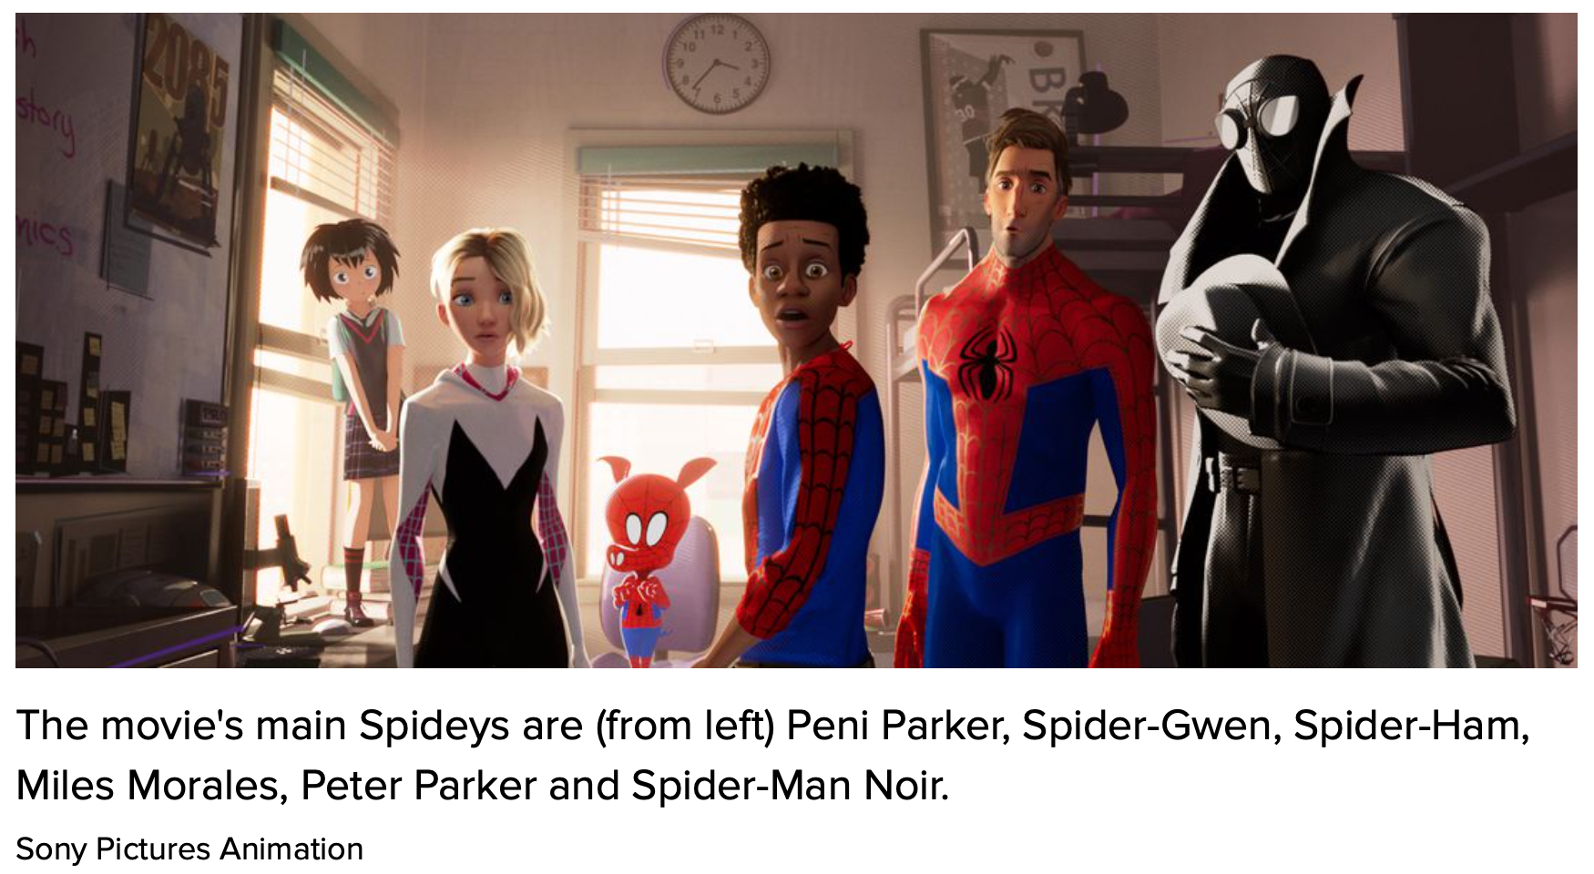
$500K/Minute
To make a video that fully grabs your attention…
Admittedly, this two-hour video was best-in-the-world for 2018
As shown by how my first cousin Phil and his team made Columbia, Sony, & Marvel rich… richer…
Notes:
Now, it can be done. The theme of which my first cousin Phil Lord down in Ell-Ay was one of the heads did it. But they spent $500,000 per minute creating _Spiderman: Into the Spiderverse_. Do that, and you can create something that is fully immersive and more effective than anything we see in person. Of course, you need more than money: you need genius too, and a lot of luck.

Slide 18

Solo Origin Story
Phil & team were bounced due to “creative differences”…
They were given the greenlight, but Disney executives did not then like what they had agreed to…
Lost $80 million on an insufficiently arresting video. Destroyed all future Star Wars origin spinoffs
Notes:
How much luck? Consider _Solo: A Star Wars Story_. The team composed of Phil and company were bounced out of the project in the middle due to “creative differences”. As I understand it, they had proposed to make a Star Wars movie that was a lot more like _Guardians of the Galaxy_ had been. They were given the greenlight. But in the middle of the project the Disney executives decided that the movie that they did not want to eat what they had ordered. So I will never see Phil, Chris, and the team’s view of the Han Solo origin story. Instead, we have a movie that lost Disney $80 million, and that brought a screaming halt to a number of projects—in fact, to all of what was supposed to be a series of future Star Wars origin spinoffs. Making convincing and arresting video is very hard.

Slide 19
We Thus Have an Uphill Climb
We don’t have $500K/minute to spend
And we here are not creative geniuses like my first cousin Phil and his team are.
We face an intellectual crisis
Hence this meta-module
Not learning, but learning how to try to learn
Plus: What is economics, and what is it good for?
Notes:
We thus have an uphill climb. We don’t have $500K/minute to spend. And we here are not creative geniuses like my first cousin Phil and his team are. American universities are frantically piling online so that we can keep teaching. And as we do so we face an intellectual crisis about how to do our job through a screen—which is a very difficult task. Unless and until we successfully figure out how to do our job through a screen, we are going to make a total hash of moving online. Hence this first, preliminary, module of this course: a meta-module; a “how are we going to try to learn this semester” module. And also in this module I also ask and suggest some possible answers to the questions: what is economics? And: what is economics good for?
Once again: welcome. I very much hope you learn stuff here, wherever “here” is, virtually. And I very much hope you have some fun here this semester.

Slide 20
Catch Our Breath…
Ask a couple of questions?
Make a couple of comments?
Any more readings to recommend?
<>

Slide 21
Required Readings: Module 0.2. Prefatory Note for Required Reading: Matuschak
The university got its start when books were expensive: really expensive. In the year 301, in the time of the Roman Emperor Diocletian, a scribe’s copying cost of 25 𐆖 for 100 lines meant that a relatively short book by our standards cost as much as 100 days’ work of an unskilled laborer. That’s the same multiple of the pay of a minimum wage worker in California today as $120,000.
Back then, gathering students in the same place along with a library was the only even faintly cost-effective way for them to read lots of books themselves, and listen to lots of books being read aloud (and commented on) by the lecturer.
But with Johann Gutenberg’s movable type printing press in the 1400s books became really cheap. By the 1800s books cost 1/100 times as much on the minimum-wage scale as in 300: the equivalent of not $120,000 but $1,200. And today? My oh my!
Especially if we count virtual books on our devices.
Yet the university, even though its fundamental reason for being was gone—you could now curl up with lots of good books anywhere, cheaply—not only survived: it flourished.
Why?
Andy Matuschak’s Why Books Don’t Work proposes an answer: Most people are bad at reading. Hence you have to gather them into a university and force them into its social networks and practices in order to make people do the things necessary for them to even do a half-assed job of learning from the books they might read.
Now some people are excellent readers on their own.
Consider Niccolo Machiavelli, living in the Italian city of Florence in the late 1400s, living in the very first generation when books were cheap enough that some people had personal libraries. When he entered his library, he wrote:
I take off my workday clothes, covered with mud and dirt, and put on the garments of court and palace. Fitted out appropriately, I step inside the venerable courts of the ancients, where, solicitously received by them, I nourish myself on that food that alone is mine and for which I was born; where I am unashamed to converse with them and to question them about the motives for their actions, and they, out of their human kindness, answer me. And for four hours at a time I feel no boredom, I forget all my troubles, I do not dread poverty, and I am not terrified by death…
For Machiavelli, reading a book was the same thing as having an active conversation. Just the thoughts and ideas that went through his mind as he read were linked into his memory and became part of his intellectual human capital.
But if you do not read actively, it simply does not work. Your brain is very good at dumping information that it concludes is trivial and useless.
And how does it assess what is trivial and useless? It decides anything that flashes before your eyes once, or twice, or three times, but that never in pills you to say or do anything and never gets hooked into your broader mental network of associations and ideas—that is what needs to be dumped.
The in-person university does a half-assed job of turning its students into active readers, into active learners. It does only a half-assed job, however. It could be vastly improved (that is mostly what Matuschak’s article is about). But that is a discussion for another day, as we no longer have the in-person university.
We need to make what we have do a better job at assisting students to be active readers and learners.
If it doesn’t, then all you will be left with are books. And as Sokrates warned, a book is inadequate:
[Written words,] said Theuth, “will make the Egyptians wiser and give them better memories… [and] wit”.
Thamus replied: “O most ingenious Theuth… this discovery of yours will create forgetfulness in the learners' souls, because they will not use their memories; they will trust to the external written characters…. You give your disciples not truth, but only the semblance of truth; they will be hearers of many things and will have learned nothing; they will appear to be omniscient and will generally know nothing; they will be tiresome company, having the show of wisdom without the reality…”
Your task is to come up with a plan to make your educational experience this semester better.
——
Niccolo Machiavelli (1513): Letter to Francesco Vettori <https://github.com/braddelong/public-files/blob/master/readings/letter-machiavelli-vettori.pdf>
Andy Matuschak (2019): Why Books Don’t Work <https://github.com/braddelong/public-files/blob/master/readings/article-matuschak-books.pdf>
Plato (-370): Phaedrus <https://github.com/braddelong/public-files/blob/master/readings/book-plato-phaedrus.pdf>

Slide 22
Prefatory Note for Required Reading: Dasgupta
In your lives so far you have certainly taken at least one course in economics—probably three or four. That probably means that you have been taught, as Betsey Stevenson and Justin Wolfers put it in their textbook, to use:
four core principles… The marginal principle: Ask ‘one more?’ instead of ‘how many?’ The cost-benefit principle: Compare the relevant costs and benefits. The opportunity cost principle…. The interdependence principle…
Betsey and Justin promise us that “these four core principles form a simple but powerful framework for making even the most mundane decisions…” and claim that their book will show “the unity and power of the economic approach’, and by “learning to apply these core ideas to any new economic question they face… [students] will naturally come to ‘think like an economist’…”
But why would one want to think like this? What is thinking like an economist—rather than like a sociologist (looking for the webs of human connections and common belief), a political scientist (looking at power and at authority both given and taken), or a historian (looking at origins and development)? One wants to think like an economist because it is a useful way of thinking about the economy. What, then, is the economy? And why is “thinking like an economist”—marginal, interdependence, benefit-cost, and opportunity cost—a good way of understanding it?
Partha Dasgupta provides the best answer to those two linked questions, and in the process of doing so provides the best introduction to economics, that I have seen. His book is a game theorist's short introduction to economics. It focuses on: individual goals, individual opportunities and constraints, individual incentives, strategies, exchange, trust, and equilibrium outcomes.
It is, of course, greatly concerned with wealth and poverty—that is, after all, the point of the discipline of economics: it is an inquiry into nature and causes of the wealth of nations. You won't find in Dasgupta’s book lots of practice figuring out how price and quantity change in response to demand shocks or calculating multipliers. What you will find is the logic and rationale for why figuring out how price and quantity change in response to demand shocks or calculating multipliers is a worthwhile thing to do.
It is worth getting into your frontal brain lobes what an economy is and what thinking like an economist is because of what we are going to do this semester. We are going to study the growth of the human economy. And we are going to do so by thinking like economists.
So I want you, before class begins, to read Partha Dasgupta’s book: Economics: A Very Short Introduction
And I don’t want you to just skim it. If you do, you will then forget it—and you will have wasted an hour and a half. The problem is that our brains are very good at forgetting irrelevant information. And our brains take information that we do not find ourselves using and reusing to be irrelevant—to be thrown out so that we can focus on information relevant to the continued life and reproductive success of the East African Plains Ape. The things that we remember are things that we think about over and over again in our inner monologue. So as you read this book I want you to do what I do. I am rarely just reading: I am generally also analyzing, compressing, synthesizing, and summarizing. I am taking notes—but very brief, synthesizing and summarizing notes. And I am generally asking myself questions—and then answering them.
To get you started, let me outline the preface for you:
Dasgupta begins by stating that he will attempt in this book to provide:
An account of how economists reason
Examples of how that reasoning can be applied to (some of) the most urgent problems Humanity faces today
He is going to contrast two lives:
The life of "Becky"—the daughter of a Chicago lawyer
The life of "Desta"—the daughter of an Ethiopian farmer couple
One way to view economics is that it is an attempt to answer the question "what do humans need to do to be rich?"
Cf.: Adam Smith (1776): An Inquiry into the Nature and Causes of the Wealth of Nations
But some people are not rich—for example, Desta—and three centuries ago, back before Adam Smith's day, very, very few people were what we would call "not desperately poor"
So let me ask you: What answers does Partha Dasgupta propose to the questions of how humans can be wealthy—and why, in history and today, many humans have not grasped the opportunity? Are his answers right? How do "economists think"? And how does "how economists think" make you trust or distrust the answers that Dasgupta comes up with?
——
J. Bradford DeLong (2020): Reading Notes <https://github.com/braddelong/public-files/blob/master/book-dasgupta-reading-note-text.pdf> <https://github.com/braddelong/public-files/blob/master/book-dasgupta-reading-note.pdf> <https://github.com/braddelong/public-files/blob/master/book-dasgupta-reading-note.pptx>
Partha Dasgupta (2007): Economics: A Very Short Introduction <https://github.com/braddelong/public-files/blob/master/readings/book-dasgupta-economics.pdf>
Adam Smith (1776): An Inquiry into the Nature and Causes of the Wealth of Nations <https://github.com/braddelong/public-files/blob/master/readings/book-smith-wealth.pdf>

Slide 23

React to the Required Readings—Write & Discuss
By now you should have watched Professor DeLong's intro video to the course and to this introductory course module 0. You should also have read the reading note, and done the Dasgupta and Matuschak readings.
Now it is time for a whole-course asynchronous discussion about these readings and the introductory video. This should be completed by the midnight that ends Sa 2020-08-29.
So let me, Brad DeLong, start this discussion off by asking four questions:
Suppose we accept everything Andy Matuschak says: what does his argument tell us about how this course ought to be run?
What things that Andy Matuschak says should we reject?
What do you think is the most notable conclusion Partha Dasgupta reaches about the nature and causes of the wealth of nations?
Suppose we accept everything Partha Dasgupta says: what does his argument tell us about how this course ought to be run?
What do you think?
In order to get full credit for this discussion, provide at least two substantive contributions to the discussion. Of these contributions, at most one should be a direct response to one of my questions. The other (or others) should be responses and reactions to your classmates and their ideas and views. We want you to talk to and react to one another here…
THREADED DISCUSSION URL: <https://bcourses.berkeley.edu/courses/1493152/discussion_topics/5774300>

Slide 24
MOAR Food for Thought About Dasgupta & Matuschak
Questions about Matuschak:
How does Matuschak think lectures are better than books?
How does Matuschak think lectures are worse than books?
What does Matuschak claim that good readers do when they read books?
Why don’t people buy textbooks in order to learn subjects when they are not concurrently taking a related course?
How does Matuschak believe that books should be redesigned—or replaced—in order to help people think more deeply?
Questions about Dasgupta:
Sustainability: Why have we been able to successfully capture and use 40% of the photosynthesis on earth without already severely disrupting our planet?
Political & Social Welfare: What are T.H. Marshall's “three revolutions”, & what importance do they have in Dasgupta’s argument?
Households: Why do we think that Africa's population is likely to grow much faster than India’s population over the next fifty years?
Mechanism Design: Why did Friedrich von Hayek deserve his Nobel Prize? How, notwithstanding von Hayek’s Nobel Prize, can central planning add to societal well-being?
Human Cooperation: What are the principal advantages of building your economic network on the basis of “weak ties”?
So what are the bottom lines here?:
Suppose we accept everything Andy Matuschak says: what does his argument tell us about how this course ought to be run?
What things that Andy Matuschak says should we reject?
What do you think is the most notable conclusion Partha Dasgupta reaches about the nature and causes of the wealth of nations?
Suppose we accept everything Partha Dasgupta says: what does his argument tell us about how this course ought to be run?

Slide 25
Lectures, Slides, & Q&A: Module 0.3
Lecture slides with audio:
Typical module activity flow
Sokrates v. Machiavelli on the educational process
Dasgupta’s take on how to do economics
Logistics
Zoom Q&A session:
TBS (to be scheduled)
Optional lecture slides:
A liberal education
Link
Link

Slide 26
0.3. Lecture slides with audio
Activity flow
<https://github.com/braddelong/public-files/blob/master/econ-115-module-0-lecture-1-activities-%23tceh.pptx> 7:45 slides with audio
The educational process
<https://github.com/braddelong/public-files/blob/master/econ-115-module-0-lecture-2-education-process-%23tceh.pptx> 9:30 slides with audio
Dasgupta’s take on economics
<https://github.com/braddelong/public-files/blob/master/econ-115-module-0-lecture-3-dasguptas-takes-%23tceh.pptx> 6:15 slides with audio
Logistics
<https://github.com/braddelong/public-files/blob/master/econ-115-module-0-lecture-4-logistics-%23tceh.pptx>
Link
Link

Slide 27
Lecture: 0.3.1. Activity Flow for a Typical Module
watch:
introductory
video
read:
prefatory
reading notes
read:
assigned
readings
discuss:
(asynchronously)
readings
participate:
60 min zoom
q&a session
(post-session
quiz)
(asynchronously)
reflect & discuss
the module
do:
jupyter notebook
problem set
watch & listen:
slides with
audio
section
breakout:
45 min 8 person
zoom section
discussion (15
min with GSI)
submit
section google
doc (&, if chosen
present
talk: for 15 min
about the course
with someone
not in your section
(email zoom meeting
id to instructors)
provide
feedback
to teachers
4:30 audio; 7:45 in this slide group
Notes:
Thus we plan for the activity flow for a typical course module to be something like this:
First: watch a very short introductory video. I am, truth be told, not enamored of introductory videos. But the research indicates that I am wrong. Human faces are very arresting. Hearing my voice and looking at my face—even on a flat screen—creates a human contact and makes me much more real to you. Your brain is then much more likely to figure out that what I say may well be important, and thus take the material from this course and make permanent connections rather than dumping it. That is the only way to, as the Greek historian Thoukydides writing in the early -300s put it, make what he or I have to teach into “a treasure for all time”.
After the short introductory video, go and read the prefatory reading notes: they tell you what to look for in the assigned articles and book chapters, so that you do not start out as a blank, passive slate attempting to absorb words but rather begin to ask questions—and expect answers—from moment one.
And then read the assigned readings, and read them with intent.
After reading the assigned readings, go to the readings comprehension quiz. It is very short. Its purpose is not to test the things we want you to get out of the reading. Its purpose is, rather, so that you can judge whether you actually absorbed much from the readings at all.
If you don’t ace the quiz, go back and read the assigned readings again—this time, with more intent, and more internal dialogue.
Doing the reading is to be followed by participating in the (asynchronous, bCourses discussion thread) class-wide readings discussion. Your first contribution can be to answer one of the questions I set out to start the ball rolling. Your first contribution can be to ask a substantive question about the readings that puzzles you. Your second contribution—and your first contribution too, if you like—should be a substantial response to something that one of your fellow students says in the discussion threads. And then, if your contribution called forth substantial responses, you should at least acknowledge them.
Following this asynchronous readings discussion, I have my say. That is in fact what I am doing here: powerpoint slides with attached audio, of which I promise that no more than 40 minutes of audio a week will be required—and hopefully I will get better at compression.
Reading and listening to my slide-based audio lectures will then be followed by a 60 minute zoom q&a session, where I will answer your questions about the readings, the lectures, and the discussions so far—and I will feel free to answer questions none of you have asked if I think that it is important for you to hear my answers. The zoom q&a sessions will be saved and posted, so if you miss one you can listen to it afterwards. But I do recommend “attending” live: live has a different feel, and synchronous has its place.
The zoom q&a session will be followed by your doing the weekly problem set in a framework called the jupyter notebook. More on that will follow—in fact, more on that will follow in the first jupyter notebook problem set. Its purpose is to get you acclimated to and familiar with this system.
After the problem set, we will have three more activities in the module:
We will divide you into not 25-person sections but 8-person breakout groups, and each will have a 30 minute synchronous zoom discussion with themselves, a GSI, me the professor, or more than one of us.
2. We will have another asynchronous bCourses discussion thread, this time focused not on the readings per se but on the module as a whole. As before, your first contribution can be to answer one of the questions I set out to start the ball rolling. Your first contribution can be to ask a substantive question about the readings that puzzles you. Your second contribution—and your first contribution too, if you like—should be a substantial response to something that one of your fellow students says in the discussion threads. And then, if your contribution called forth substantial responses, you should at least acknowledge them.
3. We will require you to provide feedback to us as to how the module went for you.
And then we instructors have our zoom and our email office hours as well…
Complex? Yes. Why? Because we do not have all of the face-to-face, running into fellow students in the cafeteria, complaining on social media about the problem set (actually, I hope that we will still have that), and other activities that in the meatspace version of the course promote the active learning that is the core of the university’s value added.

Slide 28
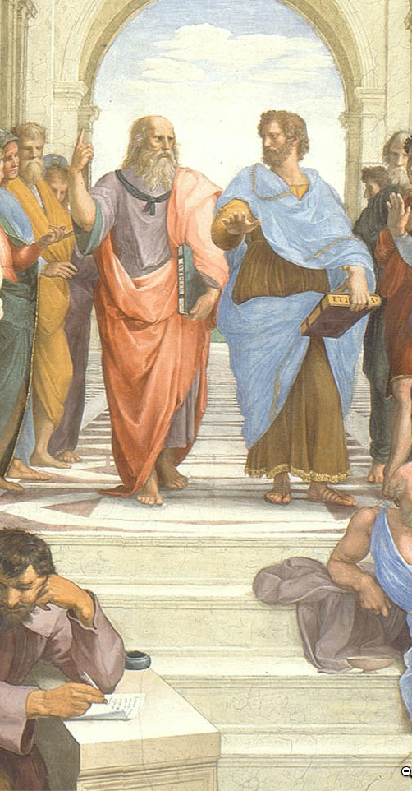

Timings: For Each Module
Aspirations for the weekly timings of the pieces of this course:
All times P[D|S]T…
0 hr: Fr 17:00: freeze all online teaching materials for the module.
Fr 17:00-Su 23:59: students do readings, discuss (asynchronously) readings (with instructors chiming in on the threads); closes at 54 hr.
Mo 00:00-Tu 15:00: students watch & listen to slides-with-audio-lectures.
72 hr: Tu 15:30: zoom q&a session
Tu 17:00-Fr 17:00: students discuss (asynchronously) the module; closes at 168 hr.
We times various: students participate in 20 min 8 person breakout zoom section sessions
We 17:00-Su 23:59: students do jupyter notebook problem set; closes at 199 hr;
Th 15:30: I will try to hold LeConte 4 for (socially-distanced) in-person office hours on the current module; 142.5 hr
Fr: students chosen to present the results from their 8 person breakout sessions give their mini talks
Fr 17:00-Su 23:59: students provide feedback to instructors; closes at 199 hr.
Mo 00:00-Tu 23:59: instructors grade & assess discussion threads, zoom participation, and jupyter notebooks; closes at 271 hr.
Next Fr 12:00-23:59: students review module
Four weeks later Fr 12:00-23:59: students re-review module
Question: Where in this staggered process are things likely to go wrong?
1:00 audio
Notes:
We have a complicated proposed schedule for the various activities—that are twelve in number—that we think will make up the typical module-week. But we reserve the right to make on-the-fly adjustments over the course of the semester. We want to do what works as far as education is concerned. We want to drop what isn’t working. We figure that we have a right to ten and only ten hours of your attention and effort each week. And we want to use those ten hours a week that you are going to give us well.
One more thing to note: we are, each week, going to also look back—review briefly what we did last week, and review in greater depth what we did four weeks ago. Plus there will be the end-of-semester review process. Reminding your brain that, yes, this is important for you to remember and make new connections mentally even if you have not seen it for a while—that kind of structured repetition is very important if your learning is to be more than evanescent.
And I want you to—immediately—email to us where you think something is likely to go wrong with this chain of activities, as far as its assisting your learning is concerned. And we want to be emailed as soon as something does go wrong.

Slide 29
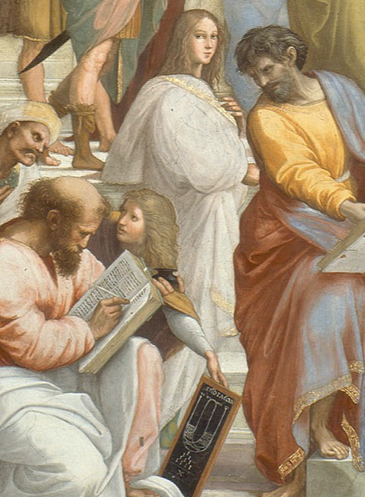
Timings: For the Semester
Notes on the timing of the semester:
First as-class-begins module online materials frozen Fr Aug 21
As-class-begins (optional, recorded) zoom q&a session Tu Aug 25
First required class zoom sessions We Aug 26
Last class day: Fr Dec 4—15 full weeks
RRR week: Fr Dec 4-Fr Dec 11
Final papers due: Fr Dec 18
Question: What else should we be asking people to do, in addition to weekly participation in the threaded discussions, weekly problem sets, & a final paper?
1:15 audio
Notes:
For the semester as a whole, you can begin the first “As Class Begins…” module on Fr Aug 25: we commit to freezing the materials in their final state then. The first of the required (to listen to; not necessarily to attend live—people’s schedules are going to get very complicated very quickly) zoom q&a session will be Tu Aug 25 15:30 PDT; zoom URL: TBA. The last class day will be Fr Dec 4. That gives us 15 full weeks—15 full modules. Plus then there will be our RRR week review. Plus then there will be our final paper.
Now here is a question: Where should we be working you harder? What else should we be asking people to do—in addition to weekly participation in the threaded discussions, weekly problem sets, & a final paper—to make this semester educationally worthwhile for you? Answers and suggestions in email to delong@econ.berkeley.edu please, with “Econ 115 Extra” as the subject line…

Slide 30
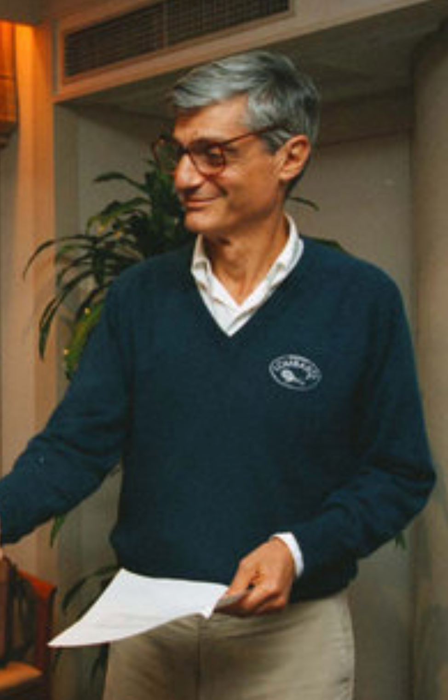
Bob Rubin’s Question
Something I have always found very useful:
Ever since I first heard it back in 1993:
What, at the end of the semester, will we wish we had done today?
Proposed answers:
I will need to hear three at the start of the zoom q&a session…
1:00 audio
Notes:
And one more thing. More than 25 years ago I learned how useful it is to ask Bob Rubin’s Question—I hope you can hear the capital “Q” in question, because it is very important—named after the former Treasury Secretary, NEC Director, and Goldman-Sachs co-head. It is very useful to ask. It is this: What, at the end of the semester, will we wish we had done today?
I will need to hear three proposed answers, at least, at the start of the zoom q&a session. For if you put yourself in your future shoes and look back at what was left undone with regret, and then if you take action, you have the greatest chance of avoiding the situations that you would later regret by taking preemptive action.
I very much want to know now what my regrets might be come December, so I can take action immediately, and so avoid them.
Please help.

Slide 31
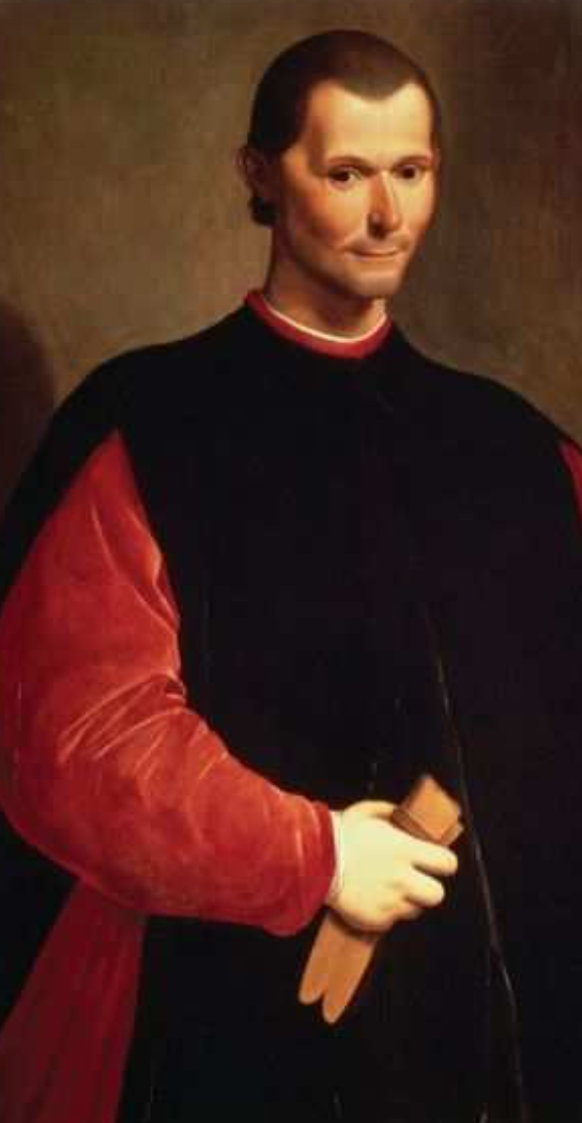
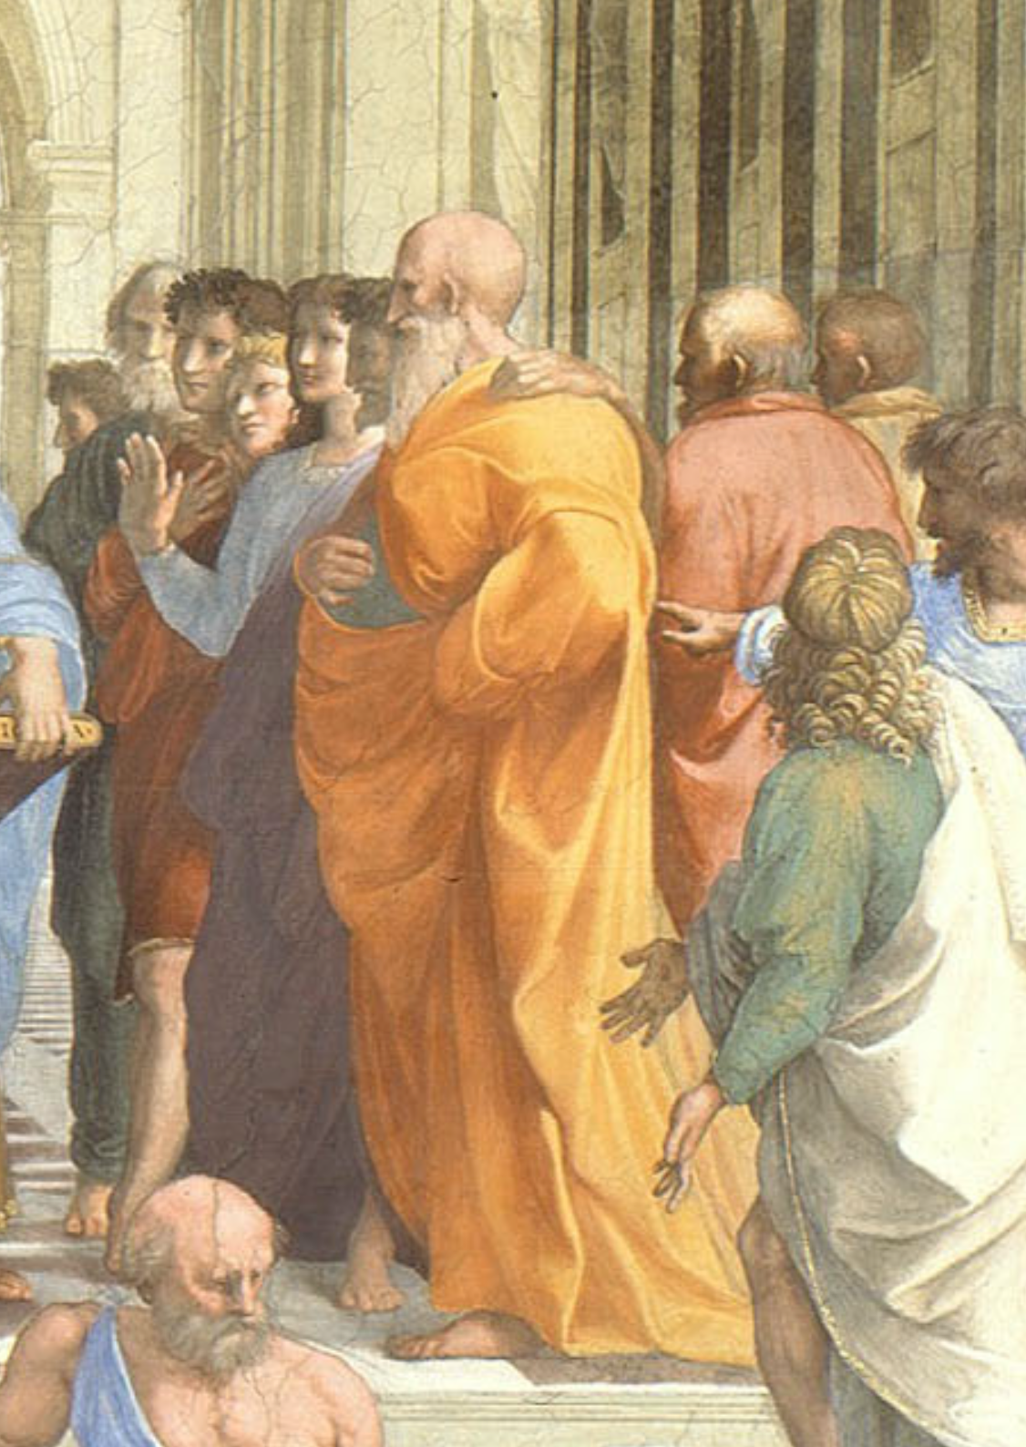
Lecture: 0.3.2. Sokrates vs. Machiavelli on the Educational Process
Machiavelli:
I… put on the garments of court and palace… step inside the venerable courts of the ancients, where, solicitously received by them, I nourish myself on that food that alone is mine and for which I was born; where I am unashamed to converse with them and to question them about the motives for their actions, and they, out of their human kindness, answer me. And for four hours at a time I feel no boredom, I forget all my troubles, I do not dread poverty, and I am not terrified by death…
Niccolo Machiavelli (1513): Letter to Francesco Vettori <https://github.com/braddelong/public-files/blob/master/readings/letter-machiavelli-vettori.pdf>
Sokrates:
The creations of the painter have the attitude of life, and yet if you ask them a question they preserve a solemn silence…. [Words] once written down they are tumbled about anywhere among those who may or may not understand them, and know not to whom they should reply, to whom not… and they cannot protect or defend themselves…. Would a husbandman… take the seeds… and in sober seriousness plant them during the heat of summer?… The serious pursuit of the dialectician… finding a congenial soul, by the help of science sows and plants therein words which are able to help themselves… and have in them a seed which others brought up in different soils render immortal, making the possessors of it happy to the utmost extent of human happiness…
Plato (-370): Phaedrus <https://github.com/braddelong/public-files/blob/master/readings/book-plato-phaedrus.pdf>
3:00 of audio in this slide; 9:30 in this slide group
Notes:
On the slide are two substantial quotes about the experience and utility of reading books for education. One was written in the early 1500s by intellectual, bureaucrat, and statesman Niccolo Machiavelli of the republic of Florence, Italy. The other was written down in the early -300s by the philosopher Plato of the Republic of Athens, Greece, reporting or claiming to report the words of his teacher Sokrates. Pause this audio track, read the two quotations, and think about them.
Machiavelli, as portrayed by himself, and Sokrates, as portrayed by Plato, have diametrically opposed views of the usefulness of books. For Machiavelli, a book is almost as good as being there with the author—indeed, books are better, because Machiavelli in his library has many authors, all at his beck and call. Sokrates, by contrast, appears to think that books are very likely to be misread and misinterpreted: “they cannot defend themselves", "they do not know to whom they should reply, to whom not”.
For Sokrates, real education is only conducted by a teacher skilled in the art of dialectic—of getting a true dialogue going that leads the student to think for themself and thus have planted in their brain “words which are able to help themselves”, which will then “make the possessors… happy to the utmost extent of human happiness”.
Machiavelli, by contrast, thinks that education is accomplished by simply throwing somebody with leisure to read into a library.
For most people almost all of the time, for some people most of the time, and for all people at least some of the time, Sokrates was right: it is hard work to learn anything but the most partial and evanescent knowledge from books. That was the point of the Andy Matuschak reading—and I hope you got that point, although right now I am wondering if starting this course by asking you to learn something by reading an article was a smart thing for me to have done.
Andy Matuschak has ideas about how to reorganize and restructure books to make reading easier, or at least better from an educational point of view. And—his complaints about university courses that consist of badly taught lectures aside—I think it is fruitful to think of universities-as-institutions as scaffoldings and support systems to make deep and durable learning from books and other media easy, or easier, or at least possible: although you cannot lead a horse to water, you cannot make them drink if they do not want to.
We now face the problem of reproducing what makes a university work—what makes students at a well-functioning university more like Machiavellis and less like the hapless students of Sokrates, who are able to learn only through the deep, focused, personal attention of one of the greatest minds known to us in human history.
How are we going to manage to accomplish this?
——
Lecture: Sokrates vs. Machiavelli on the Educational Process
Machiavelli:
I… put on the garments of court and palace… step inside the venerable courts of the ancients, where, solicitously received by them, I nourish myself on that food that alone is mine and for which I was born; where I am unashamed to converse with them and to question them about the motives for their actions, and they, out of their human kindness, answer me. And for four hours at a time I feel no boredom, I forget all my troubles, I do not dread poverty, and I am not terrified by death…
Sokrates:
The creations of the painter have the attitude of life, and yet if you ask them a question they preserve a solemn silence…. [Words] once written down they are tumbled about anywhere among those who may or may not understand them, and know not to whom they should reply, to whom not… and they cannot protect or defend themselves…. Would a husbandman… take the seeds… and in sober seriousness plant them during the heat of summer?… The serious pursuit of the dialectician… finding a congenial soul, by the help of science sows and plants therein words which are able to help themselves… and have in them a seed which others brought up in different soils render immortal, making the possessors of it happy to the utmost extent of human happiness…

Slide 32

Our Difficult Task
How do we duplicate—online—the “active learning” components that the in-person university does as a matter of course?:
MOOCs did not cut it…
The people who could learn from MOOCs are the Machiavellis—the people who turn their books into sub-Turing class instantiations of the books’ authors, and have conversations with them
Thus a MOOC, for those who could learn effectively from it, was little better than and a lot more expensive than a book
We need a plan for those of you—which is most of us—who are not Machiavellis, but rather like Sokrates’s students
People who really need a tutorial…
A professor, a GSI, a roommate, a classmate, a study group…
2:45 audio
Notes:
How do we duplicate—online—the “active learning” components that the in-person university does largely as a matter of course, and that truly skilled readers like Machiavelli did whenever they entered into their libraries and thus began a dialogue with, say, the then-1500 years dead Roman historian Titus Livius?
About a decade ago there was great enthusiasm for MOOCs—massive open online courses—as a way that, as MOOC enthusiast Sebastian Thrum then put it, he could teach tens of thousands worldwide rather than mere hundreds at Stanford. B
ut MOOCs did not cut it.
It turned out, you see, that the people who could learn from MOOCs were the Machiavellis. There are people who can turn their books in front of their eyes into sub-Turing class instantiations of the books’ authors, and have deep conversations with them: “I am unashamed to converse with them and to question them about the motives for their actions, and they, out of their human kindness, answer…” said Machiavelli. Contrast Sokrates’s students, for whom the words on the page are like “the creations of the painter [which] have the attitude of life, and yet if you ask them a question they preserve a solemn silence…. You would imagine that they had intelligence”, but they do not.
MOOCs turned out to be very like books. For those who could learn effectively from them they were fine—but also little better than and a lot more expensive than a book. For those who could not actively read books to get deep and durable learning out of them, we found out that very few of them could “take” MOOCs and do much better.
Our problem here is that now the coronavirus is largely forcing us into MOOC-land, will-we, nill-we. And as much as we want to nill-we, I do not see how we can this fall. Yes, I firmly intend to hold class this fall in LeConte 4 Tu & Th 15:30-17:00 P[D|S]T. But I do not think that the public health authorities will let more than 20 out of 150 students into the room.
So we need a plan for those of you—which is almost all of us—who are not Machiavellis all, but rather much more like Sokrates’s student the hapless Glaukon. People who really need a tutorial—from a professor, a GSI, a roommate, a classmate, a study group, & c. In the university such tutorials are easy or at least straightforward to find or at least happen by accident with considerable frequency. But online?
We face a difficult task indeed.

Slide 33
Why Do Books “Reply” to Niccolo but Not to Sokrates?
Your professors are—often—not good guides:
We are genuinely world-class at this: if we were not, we would not be here, doing what we do…
We are very good at learning from books, curled up in a chair…
We are very good at sitting in front of a screen, issuing commands and looking at the numbers that come back, in order to try to grasp in our minds the multi-dimensional shape of a dataset…
And for us it is largely unconscious…
If this is going to work for you, you need to do consciously what we do largely unconsciously
Universities are good settings for that to happen
But at a university like Berkeley, the “active learning” component happens largely by accident, as a byproduct of the formal educational process of large classes, lectures, & exams
2:15 audio
Notes:
But how do we accomplish this task? First, we have to figure out what Machiavelli is doing—figure out why books “reply” to Niccolo but not to Sokrates’s student Glaukon. And here we—your professors—are—often—not going to be good guides.
We, you see, are genuinely world-class at what Machiavelli does. If we were not, we would not be here, doing what we do, holding the jobs we hold. We are very good at learning from books, curled up in a chair. We are very good at sitting in front of a screen, issuing commands and looking at the numbers that come back, in order to try to grasp in our minds the multi-dimensional shape of a dataset…
And the kicker is: for us this process is largely if not totally unconscious. We do it. But we do not think about what we are doing when we do it.
If this is going to work for you, you need to do consciously what we do largely unconsciously. Universities are good settings for that to happen. But at a university like Berkeley, the “active learning” component traditionally has happened largely by accident, as a byproduct of the formal educational process of large classes, lectures, & exams. We as a university are quite good at it: Berkeley’s high reputation as a place to go to university is deserved. But our success is much more the result of institutional evolution via natural selection and imitation than the result of conscious design based on an accurate analysis of how to do this.
We do know that “active” plays the major role: something you read once, twice, or even three times, but then do not do anything else with—your brain will take that information, decide that it is not important, and dump it with its connections in order to free up capacity for important things, like the wardrobes of the Kardashians or the technical specifications of imperial star destroyers.
So here, as we move this class online, we are going to require that you be active: that you talk, write, and think about the materials—rather than just sit passively listening, or even reviewing.

Slide 34
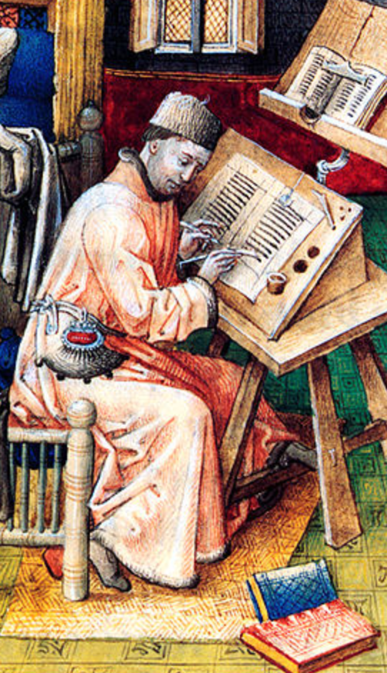
Read with Intent
If you just skim, say, Dasgupta: Economics: A Very Short Introduction:
You will then forget it—and you will have wasted an hour and a half
Our brains are very good at forgetting irrelevant information
And information we do not use and reuse is irrelevant
I want you to do what I do:
I am rarely just reading.
I am generally also analyzing, compressing, synthesizing, and summarizing.
I am taking notes—but very brief, synthesizing and summarizing notes.
And I am generally asking myself questions—and then answering them.
1:30 audio
Notes:
So: whenever you read, read with intent. If you just skim, say, Dasgupta: Economics: A Very Short Introduction, you will then forget it—and you will have wasted an hour and a half—for our brains are very good at forgetting irrelevant information, and information we do not use and reuse is classified as irrelevant
So I want you to do—consciously—what I do—largely unconsciously—when I read. When I read, I am very rarely just “reading”. I am generally also analyzing, compressing, synthesizing, and summarizing. I am thinking: that passage reminded me of something, and I am then turning away to find what it reminded me of, using the internet to refresh my recollection. I am constantly checking sources and references—that I can now do that is the glory of the internet, and I make maximum use of it. Is this author property quoting that one? What is the real context of that quotation? Did the first author intend the second author to take it that way—and even if that wasn’t the intended meaning, is it a valid meaning?
I find that I am always taking notes—but very brief, synthesizing and summarizing notes.
And I am generally asking myself questions—and then answering them—with respect to what the readings mean.
We are going to make you write, ask, answer questions, reflect, and discuss. And we are going to do so by making the typical week of this class a complicated and activity-filled chain of episodes.

Slide 35
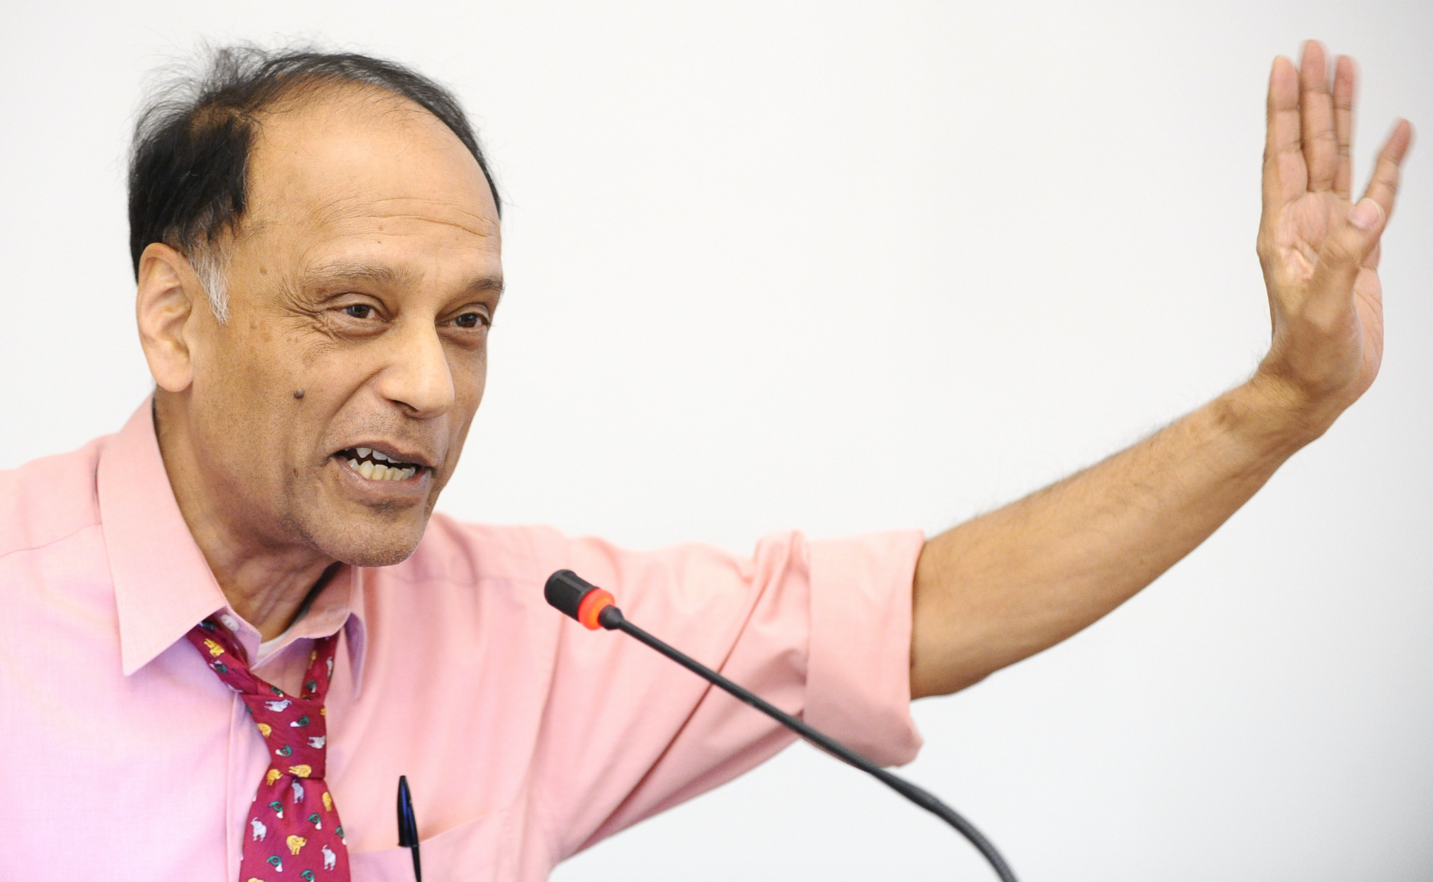
Lecture: 0.3.3 Dasgupta on Doing Economics
Why would one want to “think like an economist”?:
What is “thinking like an economist”?:
Cost-benefit
Opportunity cost
System equilibrium
Marginality
This turns out to be useful for thinking about the economy:
(Other things too: but mostly the economy)
——
Sir Partha Sarathi Dasgupta, FRS, FBA (born 17 November 1942) is Frank Ramsey Professor Emeritus of Economics at the University of Cambridge, Fellow of St John's College, Cambridge, and Visiting Professor at the New College of the Humanities, London. He was born in Dhaka, present-day Bangladesh
2:45 audio; 6:15 of audio in this slide group
Notes:
As I already said, this is not just a history course, but an economic history course. (And this is not just an economics course, but an economic history course.) In the next module we will get into what it means to take a historical view of a subject or a situation. In this module we are looking into what it means to take an economic view. Hence we had you read Dasgupta—to remind those of you have forgotten Econ 1 what economics is as a way of thought, and to reinforce in all of you your grasp of economics by providing you with what Partha Dasgupta thinks economics is for.
Dasgupta provides a non-standard introduction. Your standard introduction would set out perhaps four fundamental principles—for example, that (i) people have likes and dislikes, and thus that decisions and situations have, for the people involved, both benefits and costs; (ii) even things that seem unmixed blessings have costs—opportunity costs—for choosing to do good thing X often means that you are giving up the opportunity to do good thing Y; (iii) people’s actions interact because people are interdependent, often the vector sum of their actions and interactions will be a result that nobody intended to bring about or perhaps even wished to see, and that societies will fall into patterns of activity that reproduce themselves in the sense of providing nobody with an incentive to do anything differently—reach a system equilibrium—and (iv) that the most important individual decisions in determining the ultimate societal outcome will be the marginal decisions, the decisions made by the people who could have most easily and straightforwardly chosen otherwise.
It would then apply these principles and teach you to do things like calculate equilibrium quantities produced and sold and prices charged in the market for some good or service.
Partha Dasgupta takes a different view. He asks a game theorist’s question: how do people fall into the patterns of interaction and exchange they do? And what makes those patterns especially productive or unproductive? In so doing he attempts to model “thinking like an economist”? And he hopes that readers, by watching and following his thoughts, will be taught an answer to the question: why would one want to “think like an economist”?:
You should also think about why this economic way of thinking is particularly useful in thinking about the economy. A hint: there is an old line about the difference between economics and sociology that goes like this: economics is all about how people make choices, and sociology is about how people do not have any important choices to make.
And think about what kinds of things an economic view is likely to see especially clearly. And think about what kinds of things an economic view is likely to fail to see at all.
——
Sir Partha Sarathi Dasgupta, FRS, FBA (born 17 November 1942) is Frank Ramsey Professor Emeritus of Economics at the University of Cambridge, Fellow of St John's College, Cambridge, and Visiting Professor at the New College of the Humanities, London. He was born in Dhaka, present-day Bangladesh

Slide 36
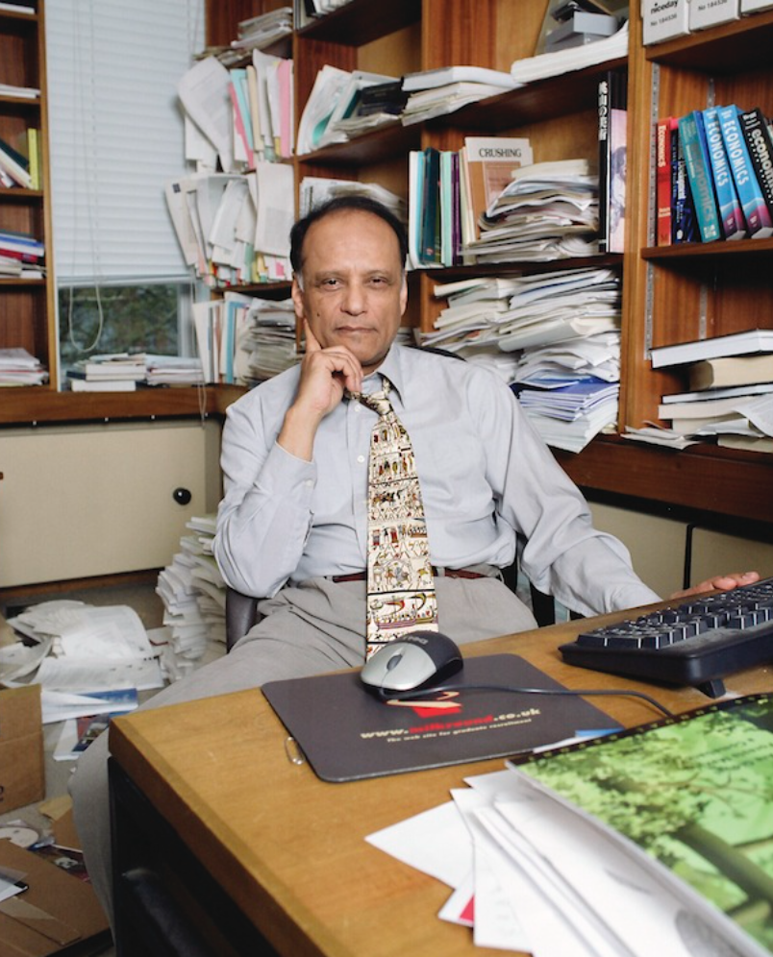
What Is the Economy?
And why is thinking like an economist the best way to analyze it?:
These are the questions Dasgupta sets out to answer by example in his book
It is a game theorist’s introduction to economics
The book won’t teach you how to calculate price and quantity changes in response to demand shocks.
The book will teach you why figuring out price and quantity changes is a worthwhile thing to do.
This is worth getting into your frontal brain lobes:
We are going to spend the semester studying the growth of the human economy
And we are going to do so by thinking like economists.
Anthology intelligence; division of labor, mechanism design; societal calculating machine
2:45 audio
Notes:
This book definitely will not teach you how to calculate price and quantity changes in response to demand shocks. That is not Dasgupta’s purpose. This book will, hopefully, teach you why figuring out price and quantity changes is a worthwhile thing to do.
This is worth getting into your frontal brain lobes, for we are going to spend the semester studying the growth of the human economy, and we are going to do so by thinking like economists.
Partha Dasgupta does model thinking like an economist: he focuses on what is going on at the margin, he looks at costs and benefits, he considers opportunity costs, and most of all he thinks in general equilibrium—how a society reaches situations in which patterns of interaction are stable, what those patterns are, and behind that the game theoretic foundations of what makes those patterns of interaction productive and unproductive.
Dasgupta's observations on the nature and causes of the wealth of nations are, I think, usefully thrown into four bins: anthology intelligence, division of labor, mechanism design, and societal calculating machines.
Because we can talk and write, we are an anthology intelligence: your brain is of use to me and my brain is of use to you, and what one of us knows or learns can be very quickly disseminated to the human race as a whole. This intellectual force multiplier makes us really smart—much smarter than any one of us could be if they had to reason things out from first principles and observations. But in order for human society to work, we need to build a system in which people are incentivized to share information rather than to transmit misinformation.
One of the things our smartness as an anthology intelligence has uncovered is the huge benefits of the division of labor: if we each specialize and each do a piece of the job, we can massively magnify our productivity. But, once again, something has to happen for society to work: we need to build into it systems in which people are incentivized to cooperate productively, rather than to steal or to hold up others.
These two lead us to the ideas of mechanism design: what societal mechanisms have we built so that we can trust each other? And how well do these mechanisms work—at what scale can we trust each other? And how can we set up a process for designing better societal mechanisms?
These thoughts lead to one of the punchlines: a properly-designed and properly-regulated market economy is an extraordinarily useful societal calculating machine for telling us what we need to do to develop knowledge, spread knowledge, and cooperate to productively use knowledge. An ill-designed or improperly-regulated market economy? Not so much.

Slide 37
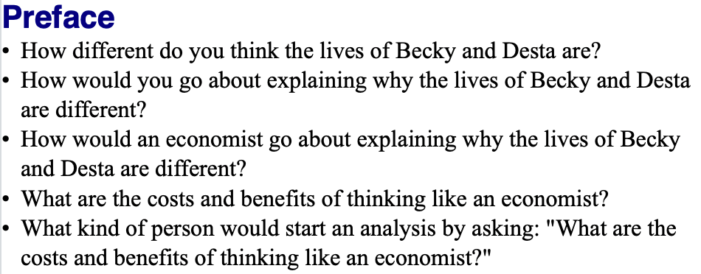
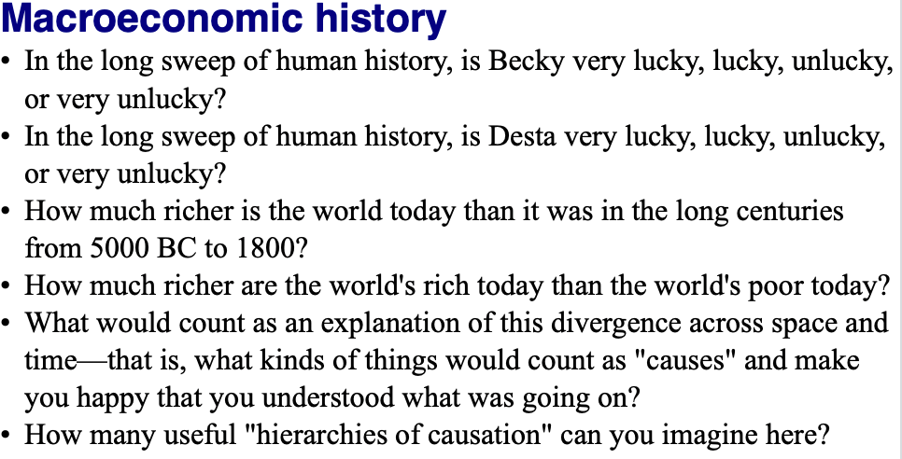
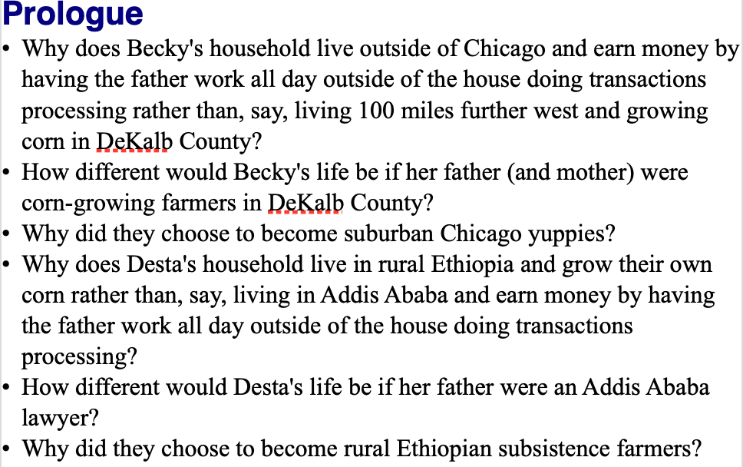
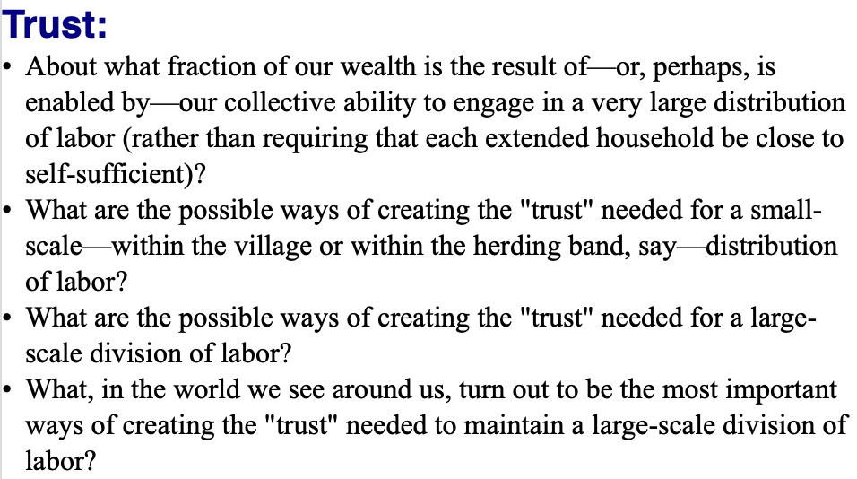
Questions
0:45 audio
Notes:
We have a number of discussion questions on Dasgupta’s little book—from 3 to 7 per chapter. Indeed, we could teach a whole course on this little book. It would be fun to do. (We would, however, have to add auxiliary readings.)
As you page through and read this and the following two slides, see how many of these questions you can successfully answer to your satisfaction off the cuff. That is a good index of the extent to which you are already engaging in “active reading”.
If your scores are low, I would advise you to think hard about what you need to do to retool how you read books, at least the books you wish to obtain some form of deep and durable knowledge from.

Slide 38
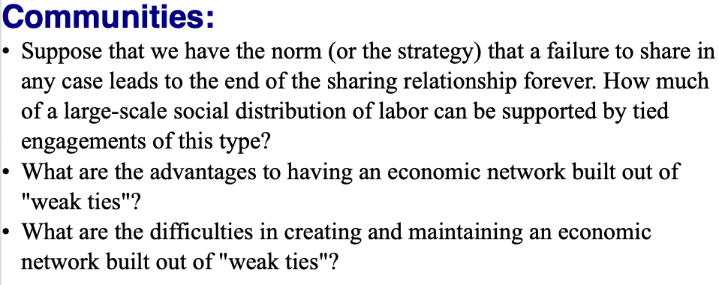
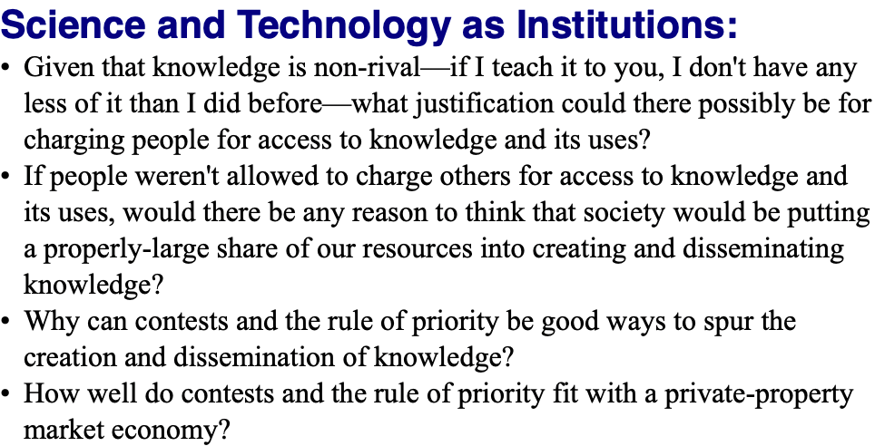
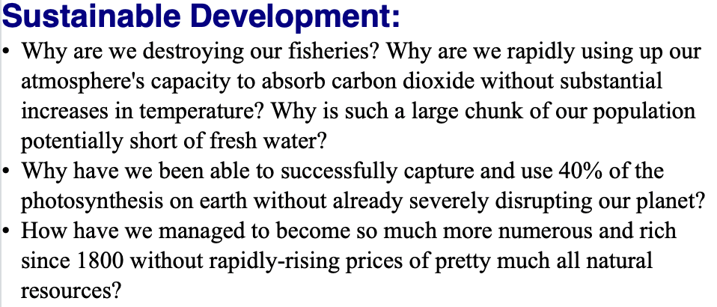
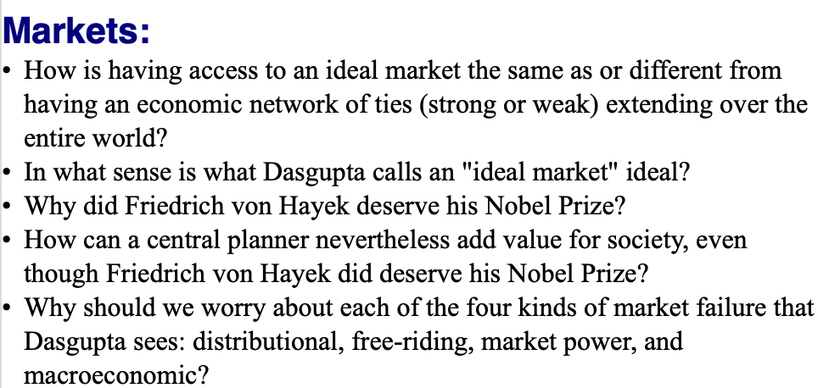
Questions II
0:00 audio

Slide 39
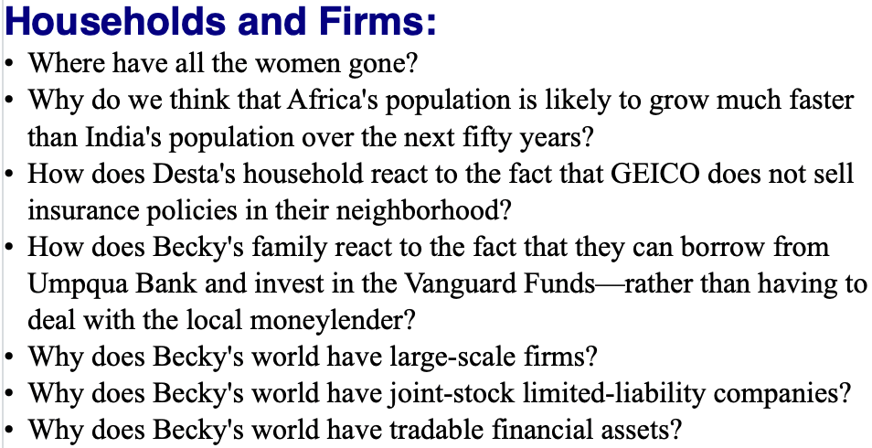
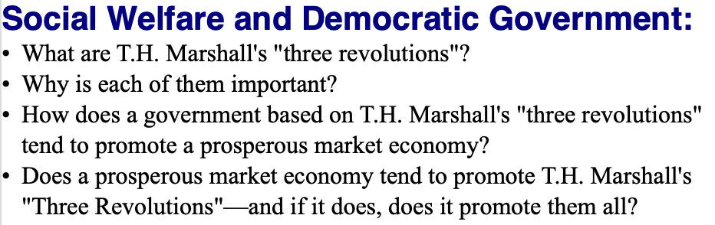
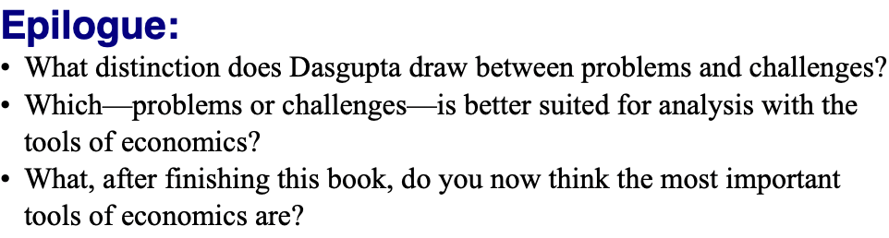
Questions III
0:00 audio

Slide 40

Lecture: 0.3.4. Logistics
Syllabus & course policies:
In the usual bCourses place: <https://bcourses.berkeley.edu/courses/1493152/assignments/syllabus>
Required readings for the course:
Principally: J. Bradford DeLong (2020): Slouching Towards Utopia?: An Economic History of the Long 20th Century
And also: Partha Dasgupta (2007): Economics: A Very Short Introduction <https://delong.typepad.com/files/dasgupta-economics.pdf>
Barry Eichengreen (2008): Globalizing Capital: A Short History of the World Monetary System <https://delong.typepad.com/files/eichengreen-globalizing.pdf>
Robert Skidelsky (2010): Keynes: A Very Short Introduction <https://delong.typepad.com/files/skidelsky-keynes.pdf>
Robert Allen (2011): Global Economic History: A Very Short Introduction <https://delong.typepad.com/files/allen-geh.pdf> <https://www.icloud.com/pages/0jK0cjqqw-D4wRayNOo87pLYw>
Plus: Andy Matuschak (2019): Why Books Don’t Work
Grading:
Quizes: 0
Discussion threads: 30 x 2 = 60 (0, 1, 2, 3)
Problem sets: 15 x 4 = 60 (0, 1, 2, 4, 5)
Zoom breakout & other participation: 20
Final paper: 60
UNWRITTEN
Notes:
As to the logistics of this course… They are standard: the syllabus and course policies are in their usual bCourses place; our course number for bCourses is 1493152. You are responsible for reading and knowing the syllabus and course policies.
The principal required reading for the course is the draft of my 20th century economic history book, which I am distributing to you.
That is not the only required book, however. We require you—as class begins—to read Partha Dasgupta’s Economics: A Very Short Introduction as a warmup exercise: it is not a substitute for but rather a complement to Econ 1, and it is meant to remind you of economics as a discipline and get your thoughts moving as to what a history course like this that is an economic history course is likely both to see clearly and not see at all as we look at world history in the 20th century.
We require you—as class begins—to read Robert Allen’s Global Economic History: A Very Short Introduction as a cooldown exercise and as a review. Allen has a somewhat different take on the world economy in the 20th century than I do. Reading him will: (a) provide a critique of my interpretation that you may find useful, (b) remind you of my interpretation, especially where it differs from his, and so aid in active learning, and (c) possibly strike sparks for questions you might investigate as you go about researching for your final papers.
In between, we have Barry Eichengreen (2008): Globalizing Capital: A Short History of the World Monetary System, which we will read throughout the course. The international monetary system is the nervous system of the world economy. Its functions and dysfunctions are key. Barry provides a lot more background into how it functioned in different eras and thus how it fed into the rest of world economic history than I do. In between, we also have Robert Skidelsky (2010): Keynes: A Very Short Introduction. It is said that the history of the fall of the Roman Republic in the -100s is, given our source limitations, essentially the biography of the Roman consul and politician Marcus Tullius Cicero. A huge chunk of 20th century global economic history is the biography of John Maynard Keynes and his ideas. And Skidelsky is a brilliant writer: truly a pleasure to read or so I find him.
Plus we will assign a number of articles—the first of which, Andy Matuschak: Why Books Don’t Work, you should have already read before you got to this lecture.
A note on grading. We will bump up the grades of people whose contributions to synchronous discussions make us think that they got the shaft in the formal point-attribution grading process—that is what the 20 “participation” points are. Quizzes are ungraded: they are supposed to be low stakes exercises. Otherwise, we will split points between asynchronous web discussions, problem sets, and the final paper 1/3-1/3/-1/3.
Contributions to each of the 30 discussion threads will be graded on a 0-2 scale: 0 means that you did not complete the assignment before it closed; 1 means that in our view you simply phoned in your contribution, and did not make an effort; 2 means that you attempted to make a serious contribution to the discussion; 3 we reserve for someone whose contribution genuinely taught us something.
The 15 problem sets will be graded on a 0-4 scale. 0 means that no assignment was submitted or that it was submitted more than 48 hrs after the assignment closed; 1 means that the assignment was submitted up to 48 hrs late; 2 means that the assignment was phoned in, with major components not seriously attempted; 3 means that you attempted all the major pieces but did not successfully complete some important aspects; 4 means that you successfully completed the problem set; 5 means that your problem set was sufficiently ingenious and excellent that it taught us, the instructors, something.

Slide 41
Grading
Haas:
Mean elective grade: about 3.5
That seems reasonable: B+/A-
Grading:
Quizes: 0
Discussion threads: 30 x 2 = 60 (0, 1, 2, 3)
Problem sets: 15 x 4 = 60 (0, 1, 2, 4, 5)
Zoom breakout & other participation: 20
Final paper: 60
Points to letter grades:
The way it works is this:
We form our holistic assessment of the degree of effort and accomplishment of the class as a whole,
largely but not exclusively based on the scores people receive on assignments.
That assessment then sets the grade distribution.
We then take the assignment scores, adjust them for notable participation-based assistance in helping others learn, and rank all of you students.
By effort & achievement.
Thus there is not a strict curve:
someone else doing better does not lower your grade.
In fact, it is the opposite—your helping someone else do better raises the average grade and, to the extent that we notice, directly raises yours as well.
But there is also not a rigid set of numerical cutoffs you will be able to count on
Oral exams for edge cases…
UNWRITTEN
Notes:
As to the logistics of this course… They are standard: the syllabus and course policies are in their usual bCourses place; our course number for bCourses is 1493152. You are responsible for reading and knowing the syllabus and course policies.
The principal required reading for the course is the draft of my 20th century economic history book, which I am distributing to you.
That is not the only required book, however. We require you—as class begins—to read Partha Dasgupta’s Economics: A Very Short Introduction as a warmup exercise: it is not a substitute for but rather a complement to Econ 1, and it is meant to remind you of economics as a discipline and get your thoughts moving as to what a history course like this that is an economic history course is likely both to see clearly and not see at all as we look at world history in the 20th century.
We require you—as class begins—to read Robert Allen’s Global Economic History: A Very Short Introduction as a cooldown exercise and as a review. Allen has a somewhat different take on the world economy in the 20th century than I do. Reading him will: (a) provide a critique of my interpretation that you may find useful, (b) remind you of my interpretation, especially where it differs from his, and so aid in active learning, and (c) possibly strike sparks for questions you might investigate as you go about researching for your final papers.
In between, we have Barry Eichengreen (2008): Globalizing Capital: A Short History of the World Monetary System, which we will read throughout the course. The international monetary system is the nervous system of the world economy. Its functions and dysfunctions are key. Barry provides a lot more background into how it functioned in different eras and thus how it fed into the rest of world economic history than I do. In between, we also have Robert Skidelsky (2010): Keynes: A Very Short Introduction. It is said that the history of the fall of the Roman Republic in the -100s is, given our source limitations, essentially the biography of the Roman consul and politician Marcus Tullius Cicero. A huge chunk of 20th century global economic history is the biography of John Maynard Keynes and his ideas. And Skidelsky is a brilliant writer: truly a pleasure to read or so I find him.
Plus we will assign a number of articles—the first of which, Andy Matuschak: Why Books Don’t Work, you should have already read before you got to this lecture.
A note on grading. We will bump up the grades of people whose contributions to synchronous discussions make us think that they got the shaft in the formal point-attribution grading process—that is what the 20 “participation” points are. Quizzes are ungraded: they are supposed to be low stakes exercises. Otherwise, we will split points between asynchronous web discussions, problem sets, and the final paper 1/3-1/3/-1/3.
Contributions to each of the 30 discussion threads will be graded on a 0-2 scale: 0 means that you did not complete the assignment before it closed; 1 means that in our view you simply phoned in your contribution, and did not make an effort; 2 means that you attempted to make a serious contribution to the discussion; 3 we reserve for someone whose contribution genuinely taught us something.
The 15 problem sets will be graded on a 0-4 scale. 0 means that no assignment was submitted or that it was submitted more than 48 hrs after the assignment closed; 1 means that the assignment was submitted up to 48 hrs late; 2 means that the assignment was phoned in, with major components not seriously attempted; 3 means that you attempted all the major pieces but did not successfully complete some important aspects; 4 means that you successfully completed the problem set; 5 means that your problem set was sufficiently ingenious and excellent that it taught us, the instructors, something.

Slide 42
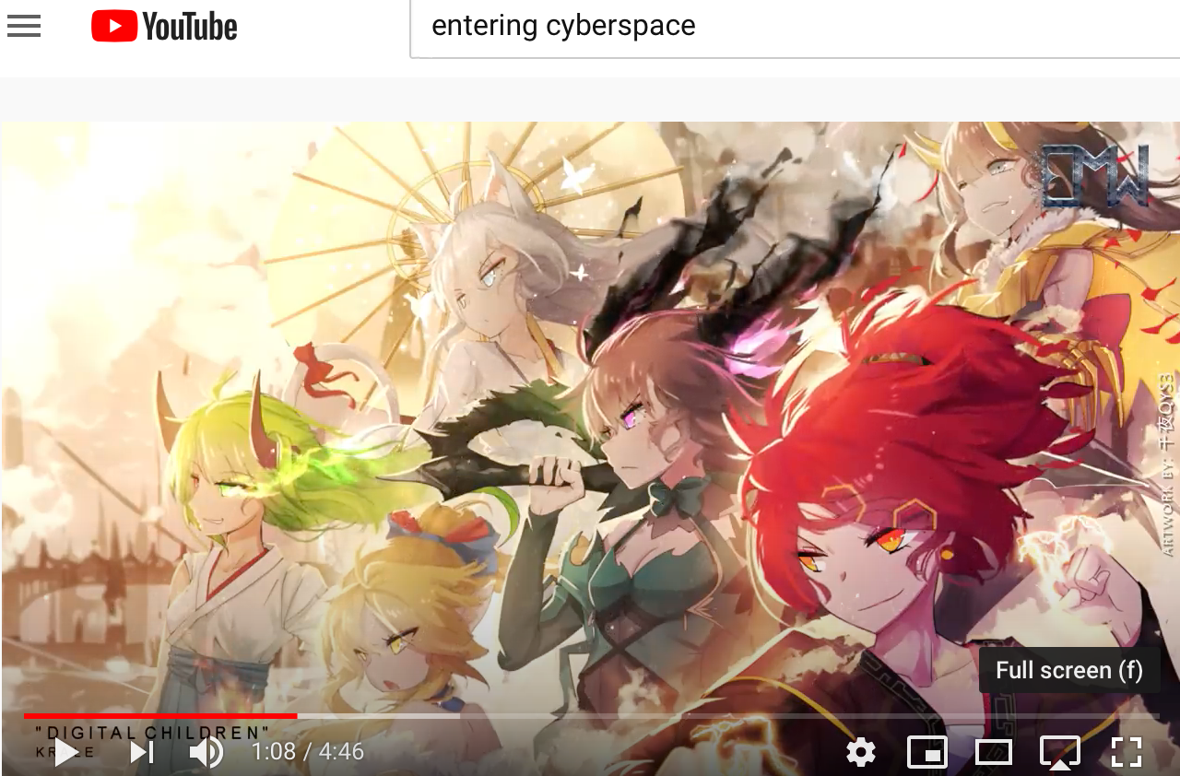

0.3. Zoom Q&A Session: Module: As Class Begins…: On How to Accomplish Online Economics Education
Time: Th Aug 27 15:30 PDT. Zoom URL: TBA.
Questions:
What, at the end of the semester, will we wish we had done today in terms of structuring this course? (I want three suggestions.)
We know of Sokrates’s uneasiness about books as opposed to in-person teaching only because Plato wrote a… book; how did Plato write his book in an attempt to get around Sokrates’s objections to the idea of teaching via making people read books?
How does Andy Matuschak hope to build websites—and author books—that will be easy to read well?
Even by people who are not (or not yet) good active readers
How are we to train you to become good active readers?
What does Partha Dasgupta think “thinking like an economist” is?
How is it different from what you were taught in Econ 1? How is it the same?
Is his Economics: A Very Short Introduction properly titled? Should it instead have been called: The Economy: A Very Short Introduction?
In the way of assignments for this course, what else should we be asking people to do, in addition to weekly participation in the threaded discussions, weekly problem sets, & a final paper?
Where in the staggered module flow process we instructors have set up are things likely to go wrong?
Music for Entering Cyberspace: "DIGITAL CHILDREN" by @Krale <https://www.youtube.com/watch?v=goks2xcpH0o>
80 min zoom q&a session (starts 15:30 PDT Berkeley time—i.e. 15:40)

Slide 43
Takeaways from & Extensions of Ideas…: Module 0.4. Asynchronously Write & Discuss
Let me start this discussion off by asking three questions:
Did the “Introduction to Jupyter Notebooks” assignment “work” for you?
What are our chances of making this course a fully worthwhile educational experience for you? What is the most essential thing to make sure we accomplish?
What important pieces of history is this economics-centered course likely to overlook? How is that going to make this course less worthwhile than an ideal course would be?
For full credit for this discussion, provide at least two substantive contributions to the discussion, of which at most one should be a direct response to one of my questions. We want you to talk to & react to one another here…
THREADED DISCUSSION URL: <https://bcourses.berkeley.edu/courses/1493152/discussion_topics/5774299/>
130 words

Slide 44
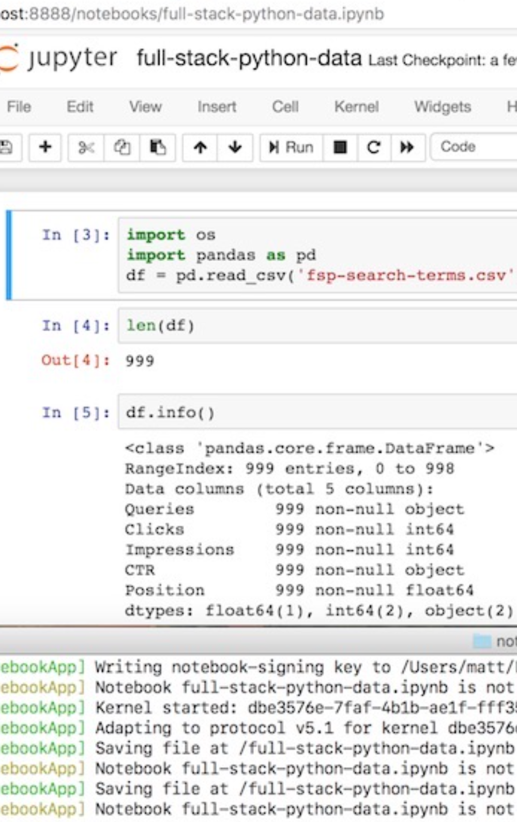
Problem Set 0. Jupyter Notebook…
JUPYTER NOTEBOOK URL:
<http://datahub.berkeley.edu/user-redirect/interact?account=braddelong&repo=lecture-support-2020&branch=master&path=ps00.ipynb>
Click on (or copy and paste in your browser URL/search field) the link above, and page through the interactive jupyter notebook document, following the instructions…
With what looks to be a permanent and long-run partial moving-online of the university, the already important topic of “data science” seems likely to become even more foundational.
Hence this first problem set tries to provide you with an introduction—to “data science”, and to the framework we will be using for problem sets that we hope will make things much easier for you and for us…
Notes:
PS00 URL: <http://datahub.berkeley.edu/user-redirect/interact?account=braddelong&repo=lecture-support-2020&branch=master&path=ps00.ipynb>
With answers: <https://nbviewer.jupyter.org/github/braddelong/lecture-support-2020/blob/master/ps00-answers.ipynb>

Slide 45
Sections: Module 0.5. 8-Person Breakout Sub§
As a group, write up and submit a one-page outline for a ten minute talk on:
What do you think is right and what do you think is wrong in the argument Partha Dasgupta makes in his Economics: A Very Short Introduction?
Ten students a week will be asked to give such a talk based on the Google doc they constructed, over zoom, to one of the teaching staff…
TEMPLATE URL: <https://github.com/braddelong/public-files/blob/master/%23econ-115-presentation-outline-template-module-0-dasgupta.rtf>
130 words

Slide 46
Catch Our Breath: Module 0.6…
Ask a couple of questions?
Make a couple of comments?
Any more readings to recommend?
Notes:
C.P. Snow (1959): The Two Cultures & the Scientific Revolution <https://github.com/braddelong/public-files/blob/master/readings/book-snow-two-cultures.pdf>: ‘A good many times I have been present at gatherings of people who, by the standards of the traditional culture, are thought highly educated and who have with considerable gusto been expressing their incredulity at the illiteracy of scientists. Once or twice I have been provoked and have asked the company how many of them could describe the Second Law of Thermodynamics. The response was cold: it was also negative. Yet I was asking something which is the scientific equivalent of: Have you read a work of Shakespeare's?I now believe that if I had asked an even simpler question – such as, What do you mean by mass, or acceleration, which is the scientific equivalent of saying, Can you read? – not more than one in ten of the highly educated would have felt that I was speaking the same language. So the great edifice of modern physics goes up, and the majority of the cleverest people in the western world have about as much insight into it as their neolithic ancestors would have had…
Fernando Perez (2018): When Jupyter Becomes Pervasive at a University <https://www.youtube.com/watch?v=Wd6a3JIFH0s>: ‘In 2018, UC Berkeley launched a new major in data science, anchored by two core courses that are the fastest-growing in the history of the university. Fernando Pérez discusses the program and explains how the core courses, which now reach roughly 40% of the campus population, are extending data science into specific domains that cover virtually all disciplinary areas of the campus…
Greg Clark (2001): Secret History of the Industrial Revolution <https://github.com/braddelong/public-files/blob/master/readings/article-clark-secret-history.pdf>
Diocletian (301): Edict on Maximum Prices <https://github.com/braddelong/public-files/blob/master/readings/article-diocletian-price-edict-kropff.pdf>
<>

Slide 47
Addenda: Module 0.7. Learning Goals, &c.…
Six primary:
To be able to outline how a typical week’s module of this course will work
To be able to outline why we have chosen this course structure in our attempt to provide a better-than-3rd-class online education here
To critique, in an informed way, our structural choices
To be able to outline what “thinking like an economist” is good for
To be able to outline course requirements and resources
To be able to successfully complete a jupyter notebook problem set
Six secondary:
To explain to classmates why the instructors chose Andy Matuschak: Why Books Don’t Work as the first required reading for this course.
To be able to suggest an alternative first reading that, in their informed opinion, might have been a better choice given the aims of this course and this module
To explain to classmates why the instructors chose Partha Dasgupta: Economics: A Very Short Introduction as the second required reading for this course.
To be able to suggest an alternative second reading that, in their informed opinion, might have been a better choice given the aims of this course and this module
To formulate a plan for how to get the most educational juice out of this—very odd—semester
To have communicated with the instructors with respect to potential obstacles—financial, technological, or otherwise—to fully participating in all the activities of this course
Link
Link
240 words

Slide 48
Additional Readings, &c….
Notes:
C.P. Snow (1959): The Two Cultures & the Scientific Revolution <https://github.com/braddelong/public-files/blob/master/readings/book-snow-two-cultures.pdf>: ‘A good many times I have been present at gatherings of people who, by the standards of the traditional culture, are thought highly educated and who have with considerable gusto been expressing their incredulity at the illiteracy of scientists. Once or twice I have been provoked and have asked the company how many of them could describe the Second Law of Thermodynamics. The response was cold: it was also negative. Yet I was asking something which is the scientific equivalent of: Have you read a work of Shakespeare's?I now believe that if I had asked an even simpler question – such as, What do you mean by mass, or acceleration, which is the scientific equivalent of saying, Can you read? – not more than one in ten of the highly educated would have felt that I was speaking the same language. So the great edifice of modern physics goes up, and the majority of the cleverest people in the western world have about as much insight into it as their neolithic ancestors would have had…
Fernando Perez (2018): When Jupyter Becomes Pervasive at a University <https://www.youtube.com/watch?v=Wd6a3JIFH0s>: ‘In 2018, UC Berkeley launched a new major in data science, anchored by two core courses that are the fastest-growing in the history of the university. Fernando Pérez discusses the program and explains how the core courses, which now reach roughly 40% of the campus population, are extending data science into specific domains that cover virtually all disciplinary areas of the campus…
Greg Clark (2001): Secret History of the Industrial Revolution <https://github.com/braddelong/public-files/blob/master/readings/article-clark-secret-history.pdf>
Diocletian (301): Edict on Maximum Prices <https://github.com/braddelong/public-files/blob/master/readings/article-diocletian-price-edict-kropff.pdf>
<>

Slide 49
U.C. Berkeley: Economics 115: Fall 2020
The World Economy in the Long 20th Century: 1870-2016
Brad DeLong
Department of Economics & Blum Center, U.C. Berkeley; & WCEG
delong@econ.berkeley.edu
last revised: 2020-05-23
for delivery: 2020-08-29
Fall 2020 instantiation: <https://bcourses.berkeley.edu/courses/1493152>
On github: <https://github.com/braddelong/public-files/blob/master/econ-115-master.pptx>
Master file: <https://www.icloud.com/keynote/0oWNqxKlrwJZn8H1UbIfG-LBg>

Slide 50
Modules
Notionally: a sixteen week semester—the last week being review, & the first week getting off to a somewhat ragged start…
0. As class begins… <<https://www.icloud.com/keynote/0FVJH3UuqPuq91KpU0jRc1vRQ>
Grand narrative & themes
Growth & globalization 1870-1914
Empire & underdevelopment: 1870-1914
World War I & failed reconstruction: 1907-1929
The Great Depression: 1925-1941
Alternatives to the ‘classical liberal’ order: 1870-2016
World War II & cold war: 1933-1989
30 glorious years in the global north: 1945-1975
False (& true) starts to development in the global south: 1911-1990
The neoliberal turn: 1980-2005
Hyperglobalization & infotech: 1955-2016
The great recession & secular stagnation: 2005-2016
East Asia’s rise: 1870-2016
Ending the long 20th century: 2005-2016
Conclusion: looking back & looking forward: -3000-3000
Link
Link

